Slide 1
Y11 Thinking about A Level Biology!
Welcome to presentation 1!
What to expect from these resources:
An outline of the course entry requirements and structure
A taste of what the content will look like
Clear structure to prepare for learning next year and help you “Bridge the Gap” from GCSE to A Level!
Learning goal | What is A Level Biology About?!
Prior knowledge | Combined or Triple Biology
Application | Identify what the entry requirements and course structure is Begin to prepare for the transition from GCSE to A Level using independent study resources

Slide 2
Entry Requirements:
Grade 6-6 or above in Combined Science GCSEs.
Two grade 6’s in Triple Science, including Biology.
Grade 6 or above in Maths GCSE → the Maths in Biology is not easy.
An aptitude and love for Science!!

Slide 3
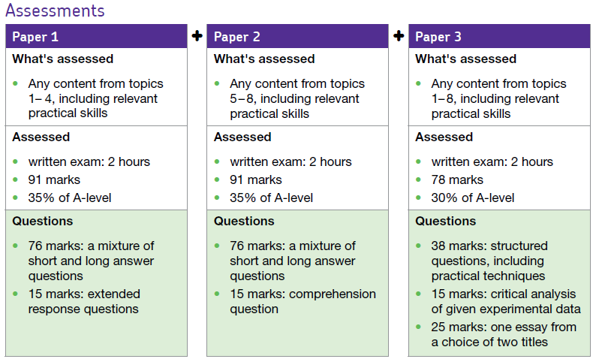
Course Structure:
There is no such thing as “AS” and “A” Level any more. You will do all your formal, external exams at the end of Year 13.
Yes, that is an essay there.

Slide 4
Using these resources:
Download the workbook. You can use this to complete the tasks set!
It is up to you if you print it and hand write your answers, use it as a structure for written notes, or complete it on the computer.
The work book is split into three sections.
Each matches with one of three power points.
Work through each power point and complete the work book as you go through!

Slide 5
Using these resources:
I have made two copies of some slides.
If you look at one slide and think “WHHAAAAT!?”
Go to the next slide, there will be an orange Hint Box there, with questions or video links to provide additional support
Hint:
Always be proactive, use the internet to find answers to questions. Don’t accept being confused and not knowing!

Slide 6
Using these resources:
REFLECT WHEN YOU ARE FINISHED:
Do you know what you want to do at university already?
If you do, great – you might know already that you need Biology
If you do not, not to worry but consider:
Is this content interesting?
As the content gets harder, will you still feel happy you chose it?
Does the maths bother you?

Slide 7
Presentation 1:
Essential Knowledge
for A Level Biology

Slide 8
A Level Biology builds on your GCSE knowledge.
Everyone finds the A Level Biology course difficult, but it is incredibly rewarding so stick at it!
This lesson summarises some of the key concepts from GCSE Biology which will help form the foundation of your study of the advanced material in A-Level.

Slide 9
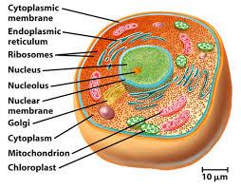
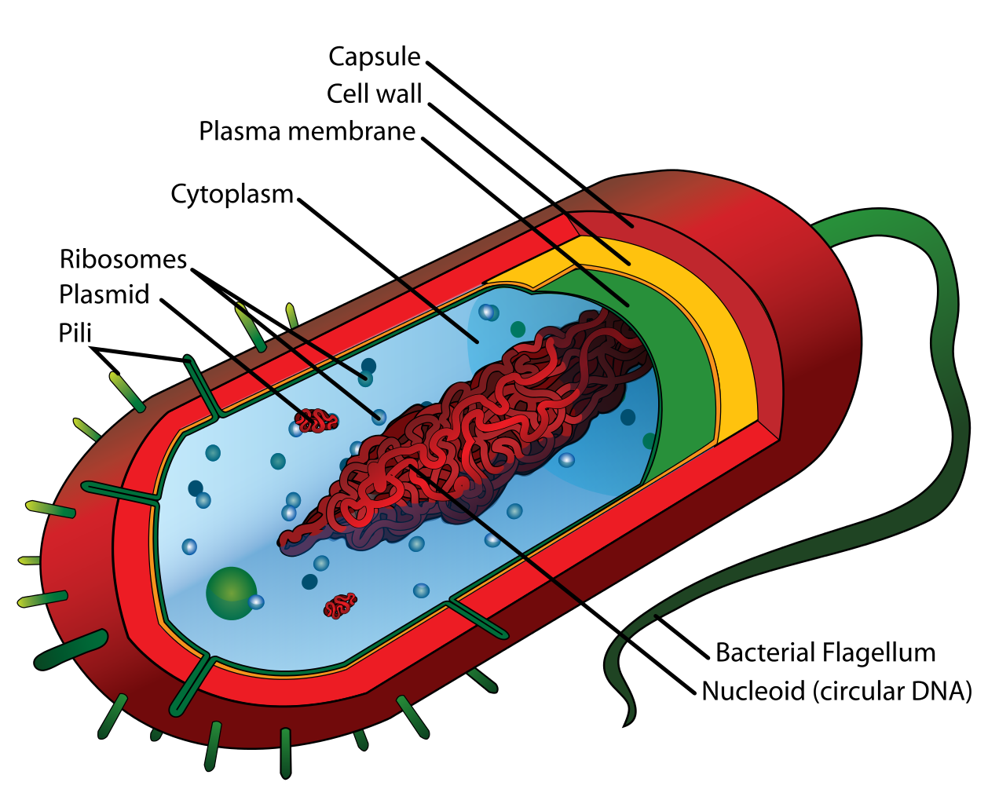
Cell Biology
The structure and function of cells explains the majority of concepts in Biology.
Throughout AS and A2 Biology you will use this knowledge to explain topics from infection and disease, control and responses, to inheritance and evolution.
Some structures are common between eukaryotes and prokaryotes, some are not.
Exam questions will explore your understanding of both the functions of these organelles and the consequences of their failure or inhibition.
Notes:
Introduce cells and cell ultrastructure as one of the foundations of knowledge for AS and A2 biology. Make connections between learning at GCSE and where this knowledge will be used and applied both in context and in unfamiliar contexts for your specification.

Slide 10
Hint:
If you do not know these key words, research them. You need independent drive at A Level.
Cell Biology
Look at the two types of cell.
The top cell is a eukaryotic cell. These contain membrane bound organelles.
The bottom cell is a prokaryotic cell. Bacteria are an example of prokaryotes.
Task:
Name as many of these organelles as you can:
Describe the function of these organelles
Suggest a consequence to the cell of these organelles not working.
Notes:
Challenge students to use and review their knowledge of cell structures.

Slide 11
Cell Biology
There will be some parts that you recognise from GCSE Science, and some parts that are new.
It is essential that you know these structures and their functions so that you can explain not only their role in healthy cells, but also how hormones, chemicals, drugs or defects prevent the normal functioning of these cells and the consequences of this to an organism.
Notes:
Introduce the concept of eukaryotic and prokaryotic cells and ensure students are clear on the differences between the two.

Slide 12
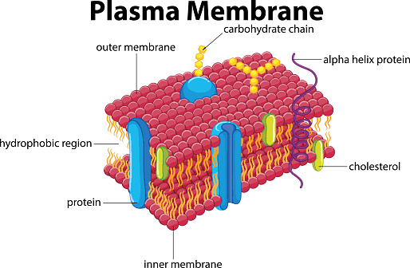
Nuclear envelope
Nucleus - the largest organelle in a cell, surrounded by a nuclear envelope that has nuclear pores. The nucleus contains the genetic material (protein bound linear DNA), necessary for controlling the cells functions.
There is a dense area known as the nucleolus where ribosomes are manufactured.
Nuclear pore
Nucleus
Nucleolus
Nucleoplasm
Chromatin
Cell-surface membrane - found on the surface of animal cells and just inside the cell wall of plant cells. Made up of a phospholipid bilayer with carrier and channel proteins within it.
It’s function is to regulate the movement of substances in and out of the cell. It contains receptor molecules which allow it to respond to hormones such as insulin.
Notes:
Teach/revise the main organelles of eukaryotes clearly identifying characteristics and functions of each one. Stress to students that they will be required to know the functions of each, to suggest the possible consequences of malfunction and be able to identify each from drawings and microscopy images.

Slide 13
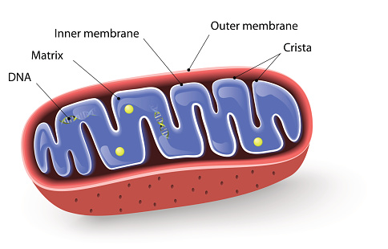
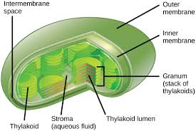
The mitochondria (on the left) is an oval shaped organelle with a double membrane. The inner membrane is folded into structures known as cristae. The inner area is known as the matrix and contains the enzymes needed for aerobic respiration. Aerobic respiration produces ATP.
Chloroplasts (on the right) are flattened structures found in plant and algal cells. They are surrounded by a double membrane. They have an internal system of membranes known as thylakoids which are stacked to form structures called grana. These are linked by lamellae. The function of the chloroplast is to carry out photosynthesis.

Slide 14
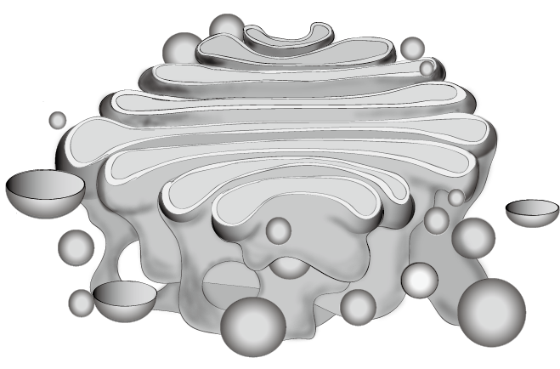
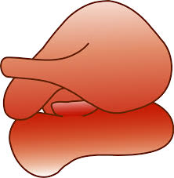
The Golgi apparatus consists of a series of flattened sacs surrounded by a membrane. Vesicles are pinched off from the sacs. Its function is to process and package molecules such as proteins and lipids. It also forms lysosomes. Lysosomes contain digestive enzymes called lysozymes used to digest invading pathogens.
Golgi vesicle
The endoplasmic reticulum can be rough (with ribosomes) or smooth (without ribosomes). The SER synthesises and processes lipids. The RER folds and processes proteins for transport around the cell.
Ribosomes are not surrounded by a membrane. They are made of protein and RNA and are the site of protein synthesis. Proteins that make proteins!

Slide 15
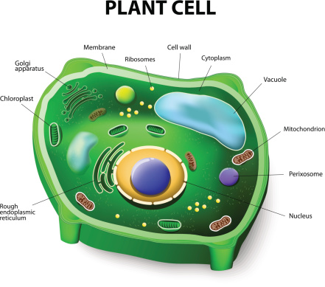
The cell wall is a rigid structure that surrounds plant, algal and fungal cells. It supports the cell and prevents it from changing shape. Cell walls can be made of cellulose, murein or chitin.
The vacuole is a membrane bound organelle found in plant cells. It contains a solution of sugar and salt known as sap. The vacuole helps to maintain pressure inside the cell and helps in getting rid of waste chemicals.
Vacuole

Slide 16
Most features of eukaryotic cells also apply to prokaryotic cells, but prokaryotic cells do differ from eukaryotic cells in a number of ways. One way in which they differ is that prokaryotic cells do not have a nucleus, DNA is not associated with proteins and is present as a circular molecule in the cytoplasm.
The cell surface membrane controls exit and entry of substances in and out of the cell.
Circular DNA carries genes that code for the proteins the cell needs. Some prokaryotes have small circles of DNA known as plasmids.
The cell wall is made of a glycoprotein called murein.
Smaller ribosomes are the site of protein synthesis.
A slimy capsule prevents the cell from drying out.
A flagellum for locomotion may be present.

Slide 17
Application of Knowledge
Examiners will test your ability to apply knowledge of these organelles in unfamiliar situations.
You will be provided with a scenario to explore and test your application of knowledge.
Be prepared to explain what deductions you have made and how you arrived at your answers.
Notes:
Provide groups of students with the following slides. Each provides a different scenario, relating to different organelles. The final example is probably the most challenging.

Slide 18
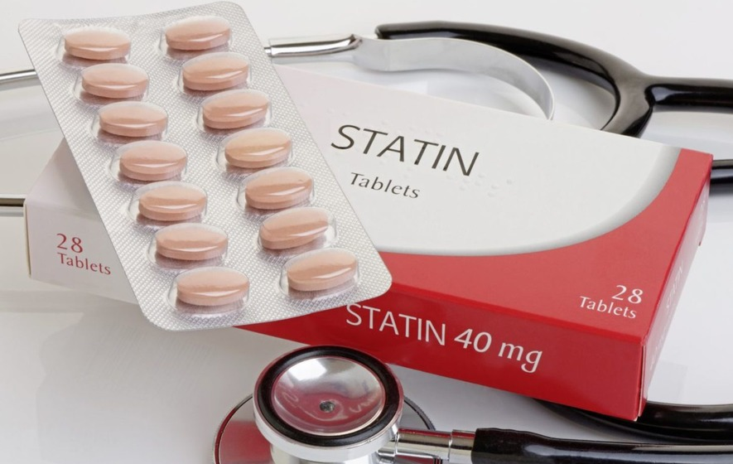
Statins are a drug prescribed to people to reduce cholesterol in their blood.
High levels of cholesterol are associated with increased blood pressure and cardiovascular disease.
Statins can reduce the amount of enzyme Q10 found in the mitochondria.
It is possible for people to take Q10 supplements available from health stores to try to reduce the impact of statins.
Questions:
Suggest and explain the symptoms of someone suffering from enzyme deficiency in the mitochondria.
Suggest how statins might reduce the amount of Q10 available in the mitochondria.
Suggest why Q10 tablets may not have the desired effect on the body.

Slide 19
Statins are a drug prescribed to people to reduce cholesterol in their blood.
High levels of cholesterol are associated with increased blood pressure and cardiovascular disease.
Statins can reduce the amount of enzyme Q10 found in the mitochondria.
It is possible for people to take Q10 supplements available from health stores to try to reduce the impact of statins.
Hint:
What do you know about the role of mitochondria in the body?
What do you know about enzymes?
How do enzymes work, what affects them?
Questions:
Suggest and explain the symptoms of someone suffering from enzyme deficiency in the mitochondria.
Suggest how statins might reduce the amount of Q10 available in the mitochondria.
Suggest why Q10 tablets may not have the desired effect on the body.

Slide 20
Statins are a drug prescribed to people to reduce cholesterol in their blood.
High levels of cholesterol are associated with increased blood pressure and cardiovascular disease.
Statins can reduce the amount of enzyme Q10 found in the mitochondria.
It is possible for people to take Q10 supplements available from health stores to try to reduce the impact of statins.
Questions:
Suggest and explain the symptoms of someone suffering from enzyme deficiency in the mitochondria.
Any sensible symptom related to mitochondrial inhibition e.g. tiredness, lethargy etc. Statins specifically cause myopathy, a condition where muscle fibres do not function properly causing muscle weakness

Slide 21
Statins are a drug prescribed to people to reduce cholesterol in their blood.
High levels of cholesterol are associated with increased blood pressure and cardiovascular disease.
Statins can reduce the amount of enzyme Q10 found in the mitochondria.
It is possible for people to take Q10 supplements available from health stores to try to reduce the impact of statins.
Questions:
2. Suggest how statins might reduce the amount of Q10 available in the mitochondria.
Statins are inhibitors and specifically inhibit the production of a precursor to Q10 (mevalonic acid). Students should be encouraged to explore their prior knowledge relating to enzymes such as inhibition and rate limiting factors.

Slide 22
Statins are a drug prescribed to people to reduce cholesterol in their blood.
High levels of cholesterol are associated with increased blood pressure and cardiovascular disease.
Statins can reduce the amount of enzyme Q10 found in the mitochondria.
It is possible for people to take Q10 supplements available from health stores to try to reduce the impact of statins.
Questions:
3. Suggest why Q10 tablets may not have the desired effect on the body.
As an enzyme, Q10 has a protein structure, proteins can be denatured by extreme pHs such as those found in the stomach, hence tablet supplements may not reach their site of action

Slide 23
Antibiotic resistance has arisen in many bacteria including staphylococci, streptococci and salmonella. Some species of bacteria have attained resistance by reducing the permeability of their cell wall to antibiotics.
Polymyxin is an antibiotic used to treat multi-drug resistant infections.
Polymyxin disrupts the cell membrane causing the cell to become more permeable.
Questions:
Suggest and explain how resistance is attained over generations of bacteria.
Suggest how polymyxin might change the structure of the cell membrane.
Suggest how changes to the cell membrane leads to cell death.

Slide 24
Antibiotic resistance has arisen in many bacteria including staphylococci, streptococci and salmonella. Some species of bacteria have attained resistance by reducing the permeability of their cell wall to antibiotics.
Polymyxin is an antibiotic used to treat multi-drug resistant infections.
Polymyxin disrupts the cell membrane causing the cell to become more permeable.
Questions:
Suggest and explain how resistance is attained over generations of bacteria.
Suggest how polymyxin might change the structure of the cell membrane.
Suggest how changes to the cell membrane leads to cell death.
Hint:
What is resistance an example of?
Review your new learning of the structure of the cell membrane.
Watch this video on bacteria and antibiotics:
https://www.youtube.com/watch?v=znnp-Ivj2ek

Slide 25
Antibiotic resistance has arisen in many bacteria including staphylococci, streptococci and salmonella. Some species of bacteria have attained resistance by reducing the permeability of their cell wall to antibiotics.
Polymyxin is an antibiotic used to treat multi-drug resistant infections.
Polymyxin disrupts the cell membrane causing the cell to become more permeable.
Questions:
Suggest and explain how resistance is attained over generations of bacteria.
Evolution by natural selection: variation, mutation, selection pressure, survival of fittest, inheritance and reference to DNA or genes.
S&C: Stronger answers might reference horizontal and vertical transmission within bacterial populations.

Slide 26
Antibiotic resistance has arisen in many bacteria including staphylococci, streptococci and salmonella. Some species of bacteria have attained resistance by reducing the permeability of their cell wall to antibiotics.
Polymyxin is an antibiotic used to treat multi-drug resistant infections.
Polymyxin disrupts the cell membrane causing the cell to become more permeable.
Questions:
2. Suggest how polymyxin might change the structure of the cell membrane.
Students should seek to describe the breakdown of the phospholipid bilayer with reference to the structure of phospholipids.
S&C: Polymyxins bind tightly to and penetrate to the cytoplasmic membrane, disrupt membrane integrity and cause lethal leakage of cytoplasmic components.

Slide 27
Antibiotic resistance has arisen in many bacteria including staphylococci, streptococci and salmonella. Some species of bacteria have attained resistance by reducing the permeability of their cell wall to antibiotics.
Polymyxin is an antibiotic used to treat multi-drug resistant infections.
Polymyxin disrupts the cell membrane causing the cell to become more permeable.
Questions:
3. Suggest how changes to the cell membrane leads to cell death.
Changes to the structure of the cell membrane by polymyxin leads to leakage of cytoplasmic contents as well as increased permeability to other antibiotic drugs. Students should make reference to diffusion and osmosis/osmotic potentials.

Slide 28
Optional Stretch and Challenge Questions

Slide 29
DKC is a rare inherited disorder. Sufferers of DKC often have shortened telomeres and display signs of premature ageing.
DKC sufferers might display symptoms including: abnormal skin pigmentation, wasting of finger and toe nails, osteoporosis (brittle bones) and pulmonary complications.
Questions:
Suggest and explain which organelle is affected by DKC.
DKC is an inherited disorder. Suggest why stem cell therapy might be the only way to treat this condition effectively. Why might this be a controversial method of treatment?
Notes:
DKC (dyskeratosis congenital) is a rare progressive congenital disorder. Poor telomere maintenance gives rise to abnormal functioning of the ribosomes (ribosomopathy). Students should identify that pigment, keratin and muscle fibres depend upon protein synthesis taking place at the ribosomes.
Students should identify that an inherited disorder indicates a problem in the genetic coding for the ribosomes themselves and that this is unlikely to be effectively treated by conventional therapy. More able students should be able to link to their knowledge of stem cells that can be ‘reprogrammed’ and inserted into sufferers in order to produce functioning ribosomes and therefore healthy proteins. Students might extend their answers to explore the different types of stem cells available. Current research suggests induced pluripotent stem cells can restore telomere length and ribosome function.

Slide 30
DKC is a rare inherited disorder. Sufferers of DKC often have shortened telomeres and display signs of premature ageing.
DKC sufferers might display symptoms including: abnormal skin pigmentation, wasting of finger and toe nails, osteoporosis (brittle bones) and pulmonary complications.
Questions:
Suggest and explain which organelle is affected by DKC.
DKC is an inherited disorder. Suggest why stem cell therapy might be the only way to treat this condition effectively. Why might this be a controversial method of treatment?
Hint:
Review protein synthesis:
https://www.youtube.com/watch?v=oefAI2x2CQM&t=14s
This question is trying to get you to see the bigger picture – from the DNA to the whole organism.
Notes:
DKC (dyskeratosis congenital) is a rare progressive congenital disorder. Poor telomere maintenance gives rise to abnormal functioning of the ribosomes (ribosomopathy). Students should identify that pigment, keratin and muscle fibres depend upon protein synthesis taking place at the ribosomes.
Students should identify that an inherited disorder indicates a problem in the genetic coding for the ribosomes themselves and that this is unlikely to be effectively treated by conventional therapy. More able students should be able to link to their knowledge of stem cells that can be ‘reprogrammed’ and inserted into sufferers in order to produce functioning ribosomes and therefore healthy proteins. Students might extend their answers to explore the different types of stem cells available. Current research suggests induced pluripotent stem cells can restore telomere length and ribosome function.

Slide 31
DKC is a rare inherited disorder. Sufferers of DKC often have shortened telomeres and display signs of premature ageing.
DKC sufferers might display symptoms including: abnormal skin pigmentation, wasting of finger and toe nails, osteoporosis (brittle bones) and pulmonary complications.
Questions:
Suggest and explain which organelle is affected by DKC.
DKC (dyskeratosis congenital) is a rare progressive congenital disorder. Poor telomere maintenance gives rise to abnormal functioning of the ribosomes (ribosomopathy). Students should identify that pigment, keratin and muscle fibres depend upon protein synthesis taking place at the ribosomes.
Notes:
Students should identify that an inherited disorder indicates a problem in the genetic coding for the ribosomes themselves and that this is unlikely to be effectively treated by conventional therapy. More able students should be able to link to their knowledge of stem cells that can be ‘reprogrammed’ and inserted into sufferers in order to produce functioning ribosomes and therefore healthy proteins. Students might extend their answers to explore the different types of stem cells available. Current research suggests induced pluripotent stem cells can restore telomere length and ribosome function.

Slide 32
DKC is a rare inherited disorder. Sufferers of DKC often have shortened telomeres and display signs of premature ageing.
DKC sufferers might display symptoms including: abnormal skin pigmentation, wasting of finger and toe nails, osteoporosis (brittle bones) and pulmonary complications.
Questions:
2. DKC is an inherited disorder. Suggest why stem cell therapy might be the only way to treat this condition effectively. Why might this be a controversial method of treatment?
Students should identify that an inherited disorder indicates a problem in the genetic coding for the ribosomes themselves and that this is unlikely to be effectively treated by conventional therapy.
S&C: Link to knowledge of stem cells that can be ‘reprogrammed’ and inserted into sufferers in order to produce functioning ribosomes and therefore healthy proteins. Students might extend their answers to explore the different types of stem cells available. Current research suggests induced pluripotent stem cells can restore telomere length and ribosome function.

Slide 33
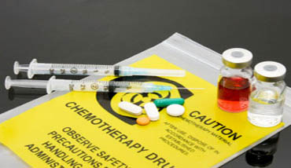
Chemotherapy is used to treat a wide range of cancers.
In chemotherapy a drug is administered that circulates throughout the body targeting cells that are dividing. Chemotherapy interrupts the process of division by damaging genes. Often a number of different chemotherapeutic drugs are used.
Questions:
A large number of drugs are packaged into liposomes in order to work effectively on the target cells. Explain why they must be packaged like this.
Suggest why chemotherapeutic drugs are more complex to deliver to their site of action than other drugs.
Suggest why a range of drugs are used in the effective treatment of cancer via chemotherapy.

Slide 34
Chemotherapy is used to treat a wide range of cancers.
In chemotherapy a drug is administered that circulates throughout the body targeting cells that are dividing. Chemotherapy interrupts the process of division by damaging genes. Often a number of different chemotherapeutic drugs are used.
Questions:
A large number of drugs are packaged into liposomes in order to work effectively on the target cells. Explain why they must be packaged like this.
Suggest why chemotherapeutic drugs are more complex to deliver to their site of action than other drugs.
Suggest why a range of drugs are used in the effective treatment of cancer via chemotherapy.
Hint:
Review the stages of mitosis (this will help with lesson 2 anyway):
https://www.youtube.com/watch?v=f-ldPgEfAHI
Review cancer:
https://www.youtube.com/watch?v=QVCjdNxJreE

Slide 35
Chemotherapy is used to treat a wide range of cancers.
In chemotherapy a drug is administered that circulates throughout the body targeting cells that are dividing. Chemotherapy interrupts the process of division by damaging genes. Often a number of different chemotherapeutic drugs are used.
Questions:
A large number of drugs are packaged into liposomes in order to work effectively on the target cells. Explain why they must be packaged like this.
Large molecules, and molecules that are charged, are unable to pass through the cell membrane; these molecules are either too big to pass, or are repelled by hydrophobic phosphate heads. Lipid based molecules can cross the cell membrane, as can very small molecules (including very small, charged molecules such as water, carbon dioxide and oxygen).

Slide 36
Chemotherapy is used to treat a wide range of cancers.
In chemotherapy a drug is administered that circulates throughout the body targeting cells that are dividing. Chemotherapy interrupts the process of division by damaging genes. Often a number of different chemotherapeutic drugs are used.
Questions:
2. Suggest why chemotherapeutic drugs are more complex to deliver to their site of action than other drugs.
Any drug delivery suffers from rapid excretion via the kidneys or via phagocytosis. Having penetrated the phospholipid bilayer, chemotherapeutic drugs must then cross the nuclear membrane (which is also double layered). Students should be able to explain that these drugs need to target the contents of the nucleus and must therefore cross two membranes before being able to do so.
Notes:
NB Stretch and challenge

Slide 37
Chemotherapy is used to treat a wide range of cancers.
In chemotherapy a drug is administered that circulates throughout the body targeting cells that are dividing. Chemotherapy interrupts the process of division by damaging genes. Often a number of different chemotherapeutic drugs are used.
Questions:
3. Suggest why a range of drugs are used in the effective treatment of cancer via chemotherapy.
Different drugs target cells at different stages of division. Students should explain that at any given time, cells could be at any point of the cell cycle. Stronger answers will identify stages of the cell cycle by name and will describe their characteristics.

