Slide 1
Y11 Thinking about A Level Physics!
Welcome to presentation 1!
What to expect from these resources:
An outline of the course entry requirements and structure
A taste of what the content will look like
Clear structure to prepare for learning next year and help you “Bridge the Gap” from GCSE to A Level!
Learning goal | What is A Level Physics About?!
Prior knowledge | Combined or Triple Physics
Application | Identify what the entry requirements and course structure is Begin to prepare for the transition from GCSE to A Level using independent study resources

Slide 2
Entry Requirements:
Grade 6-6 or above in Combined Science GCSEs.
Two grade 6’s in Triple Science, including Physics.
Grade 6 or above in Maths GCSE
An aptitude and love for Science!!

Slide 3
Course Structure:
There is no such thing as “AS” and “A” Level any more. You will do all your formal, external exams at the end of Year 13.

Slide 4
Using these resources:
Download the workbook. You can use this to complete the tasks set!
It is up to you if you print it and hand write your answers, use it as a structure for written notes, or complete it on the computer.
The work book is split into three sections.
Each matches with one of three power points.
Work through each power point and complete the work book as you go through!

Slide 5
Using these resources:
I have made two copies of some slides.
If you look at the first slide and think “WHHAAAAT!?”
Go to the second slide, there will be an orange Hint Box there, with questions or video links to provide additional support
Hint:
Always be proactive, use the internet to find answers to questions. Don’t accept being confused and not knowing!

Slide 6
Using these resources:
REFLECT WHEN YOU ARE FINISHED:
Do you know what you want to do at university already?
If you do, great – you might know already that you need Physics
If you do not, not to worry but consider:
Is this content interesting?
As the content gets harder, will you still feel happy you chose it?
Does the maths bother you?

Slide 7
Presentation 1:
Essential Prior Knowledge
for A Level Physics

Slide 8
A Level Physics builds on your GCSE knowledge.
Everyone finds the A Level Physics course difficult, but it is incredibly rewarding so stick at it!
This lesson summarises some of the key concepts from GCSE physics which will help form the foundation of your study of the advanced material in A-Level.

Slide 9
Essential Forces and Motion
Resultant Forces
If there is a resultant force on a object it will accelerate.
An acceleration is the rate change in velocity (remember velocity is a vector).
a = (v-u) / t
The larger the mass ‘m’ of an object, the larger the force ‘F’ that needs to be applied to reach the same acceleration ‘a’.
F = m.a
Hint:
https://www.youtube.com/watch?v=YGGxf6cp3Lo
Notes:
This slide can be shown as a help to the activity (which relies on prior GCSE knowledge)
Or it could be used as a help sheet for students
Or it could be used to help students peer assess the work of others

Slide 10
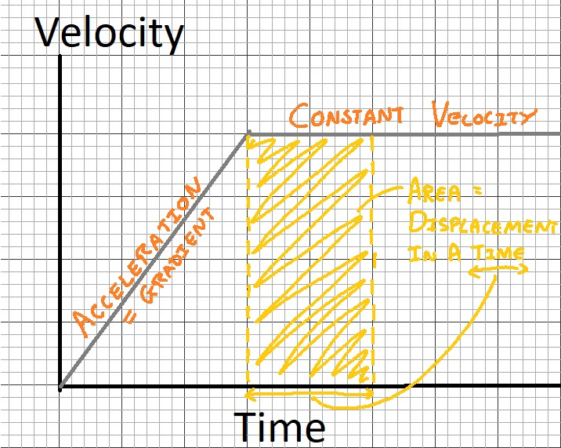
Essential Forces and Motion
Hint:
https://www.youtube.com/watch?v=4iI7f4xw0Bk
Motion Graphs
The motion of an object can be illustrated on a motion graph.
A velocity vs time graph can be used to calculate acceleration (using the gradient) or the displacement (the area under the line).
Notes:
This slide can be shown as a help to the activity (which relies on prior GCSE knowledge)
Or it could be used as a help sheet for students
Or it could be used to help students peer assess the work of others

Slide 11
Essential Forces and Motion TASK
WORK OUT THE ANSWERS!
At 0s the 10kg mass pictured is stationary before a series of forces act upon it.
Describe the motion of the 10kg mass in each of the subsequent timeframes.
Where applicable calculate the initial velocity ‘u’, final velocity ‘v’ and acceleration ‘a’ of the mass using equations you recall from GCSE Science.
Sketch a velocity vs time graph for the complete 9 seconds.
Going Deeper:
Use your graph to calculate how far the mass travelled in total.
Use your graph to derive an equation for the displacement ‘s’ of the mass after time ‘t’ given the initial 'u’ and final ‘v’ velocity.
0-3s
10kg
5N
3-6s
10kg
5N
5N
6-9s
10kg
10N
5N
Notes:
Set students approximately 10 minutes to complete the activity, longer will be required for discussion of the going deeper topics.

Slide 12
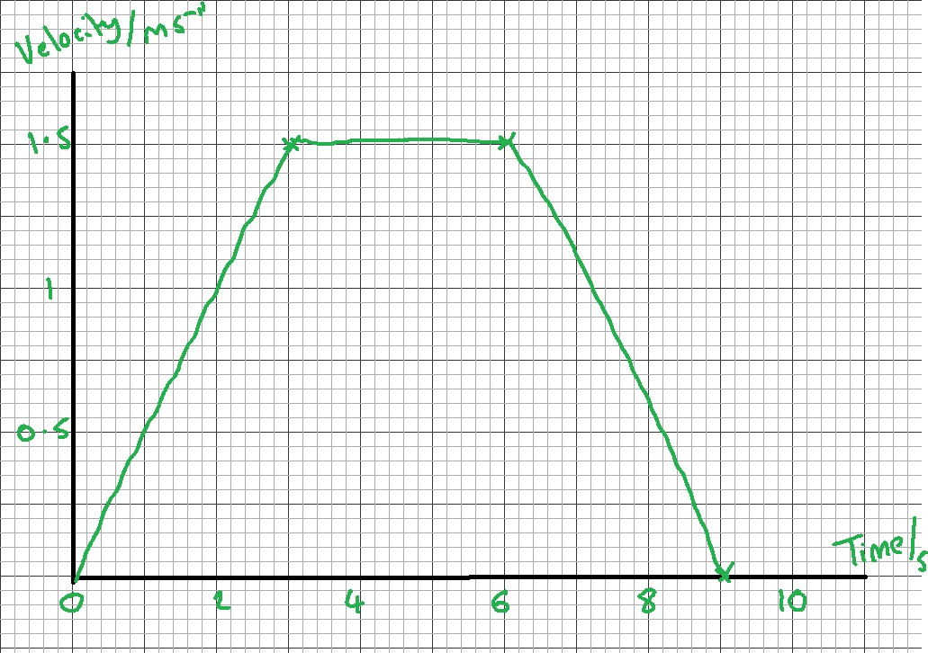
Essential Forces and Motion TASK answers
Describe the motion of the 10kg mass in each of the subsequent timeframes.
0-3 Accelerating to right
3-6 Constant velocity
6-9 Deceleration (-ve acceleration)
Where applicable calculate the initial velocity ‘u’, final velocity ‘v’ and acceleration ‘a’ of the mass using equations you recall from GCSE Science.
0-3 u=0 v=1.5m/s
3-6 u=1.5m/s v=1.5m/s
6-9 u=1.5m/s v=0
Sketch a velocity vs time graph for the complete 9 seconds.
0-3s
10kg
5N
3-6s
10kg
5N
5N
6-9s
10kg
10N
5N
Notes:
Solutions to the problems – can be peer reviewed or discussed as the class.

Slide 13
Essential DC Circuits
Hint:
https://www.youtube.com/watch?v=hRojfU77c38
Current, Potential Difference and Resistance
Current ‘I’ is the rate of flow of charge ‘Q’ in a circuit. It is measured in Amps with an ammeter in series.
I = Q/t
Potential difference ‘V’ is a measure of how much energy ‘E’ is transferred by the charge ‘Q’ as it passes through a component in the circuit. It is measured in Volts with a voltmeter in parallel.
V = E/Q
The resistance ‘R’ of a component is a measure of how difficult it is for the current to flow. It is measured in Ohms ‘Ω’. A high resistance lowers the current. Components with a high resistance will take a larger share of energy in a loop of a circuit.
V = IR
Notes:
This slide can be shown as a help to the activity (which relies on prior GCSE knowledge)
Or it could be used as a help sheet for students
Or it could be used to help students peer assess the work of others

Slide 14
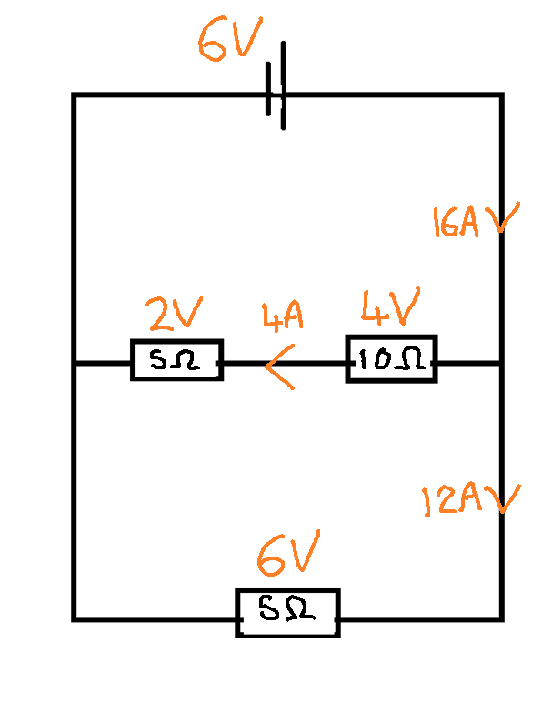
Essential DC Circuits
Series and Parallel Circuits
A series circuit is a single loop. The current is always the same at every point in the loop. The energy is shared between all components so the potential difference across each individual component will match the supply voltage of the cell.
A parallel circuit contains multiple loops. The current splits at a junction but is always conserved (the amount flowing in equals the amount flowing out). More current flows down the path of least resistance.
Each loop in the circuit gets its own supply of energy to be shared.

Slide 15
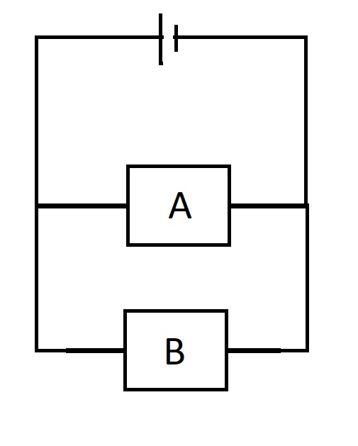
Essential DC Circuits TASK
WORK OUT THE ANSWERS!
6V Cell
Sketch and label as many circuit symbols as you can remember from GCSE Science.
Describe a simple experiment that you could perform to calculate the resistance of component B.
Complete the following table, add units to each column heading.
Component | Current flowing through it | Potential difference across it | Resistance
A | 0.1
B | 0.4
Going Deeper
What current would be flowing through the cell?
Can you write down any rules that define the behaviour of current and potential difference in series and parallel circuits?
The circuit model we have used assumes the cell has no resistance. If the cell had resistance what would happen to the potential difference across the components if there resistance was lowered?
Notes:
Set approximately 10 minutes for students to work through the tasks on the sheet – longer will be needed if discussion of the going deeper element is to take place.

Slide 16
Essential DC Circuits ANSWERS
Circuit symbols correct
Describe a simple experiment that you could perform to calculate the resistance of component B.
Connect ammeter in series measure current
Connect voltmeter in parallel - measure p.d.
Use Ohm’s Law - V = IR
EXT - Use variable resistor to vary current and plot IV graph with gradient giving resistance
3. Complete the following table, add units to each column heading.
6V Cell
Component | Current flowing through it | Potential difference across it | Resistance
A | 0.1 | 6 | 60
B | 0.4 | 6 | 15
Notes:
Solutions to the going previous slides tasks

Slide 17
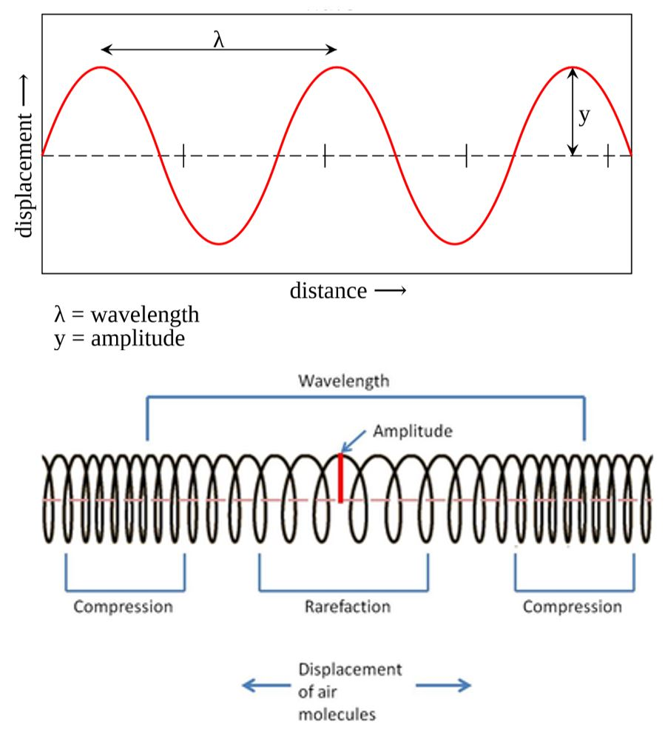
Essential Waves
Hint:
https://www.youtube.com/watch?v=h5KBL1BPX1A
What is a Wave?
Waves transfer energy without transferring matter.
Light and sound are common examples of waves.
A wave can be thought of as a series of oscillations.
There are several wave features that you should be able to recall from GCSE Science:
Wavelength - the distance between two identical points on the wave.
Amplitude - the maximum displacement of the waves oscillation
Frequency - the number of oscillations per second, measured in Hertz.
The wave equation links the wave speed ‘c’ to its frequency ‘f’ and wavelength ‘ƛ: c = f ƛ
Notes:
This slide can be shown as a help to the activity (which relies on prior GCSE knowledge)
Or it could be used as a help sheet for students
Or it could be used to help students peer assess the work of others

Slide 18
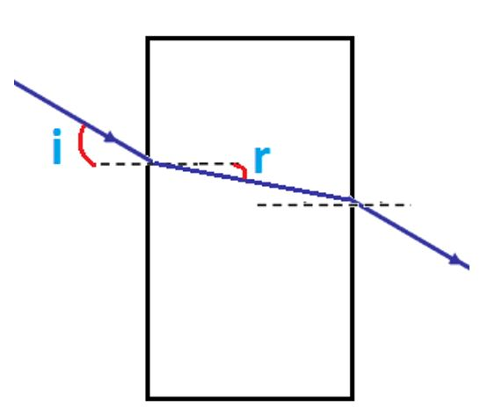
Essential Waves
Wave Properties
Waves can be reflected - the wave hits a boundary between materials and it returns back into the same material.
Waves can be refracted - when it enters a new medium its direction can change. The wave speed and wavelength change but the frequency remain the same.
Waves can be diffracted - when a wave encounters an object that is of comparable size to its own wavelength, the wave spreads out.

Slide 19
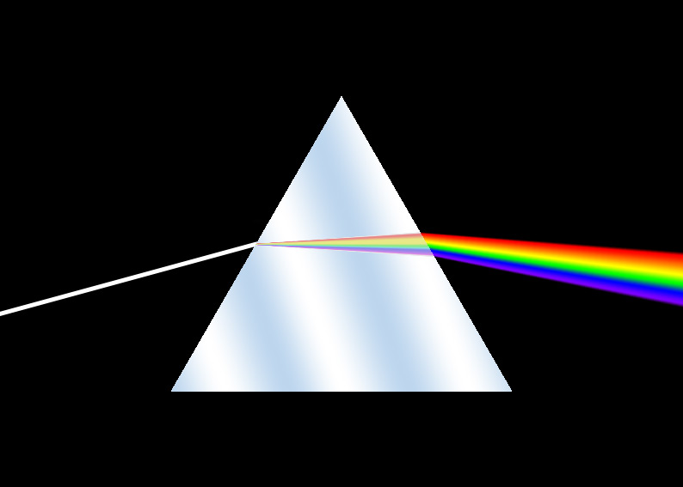
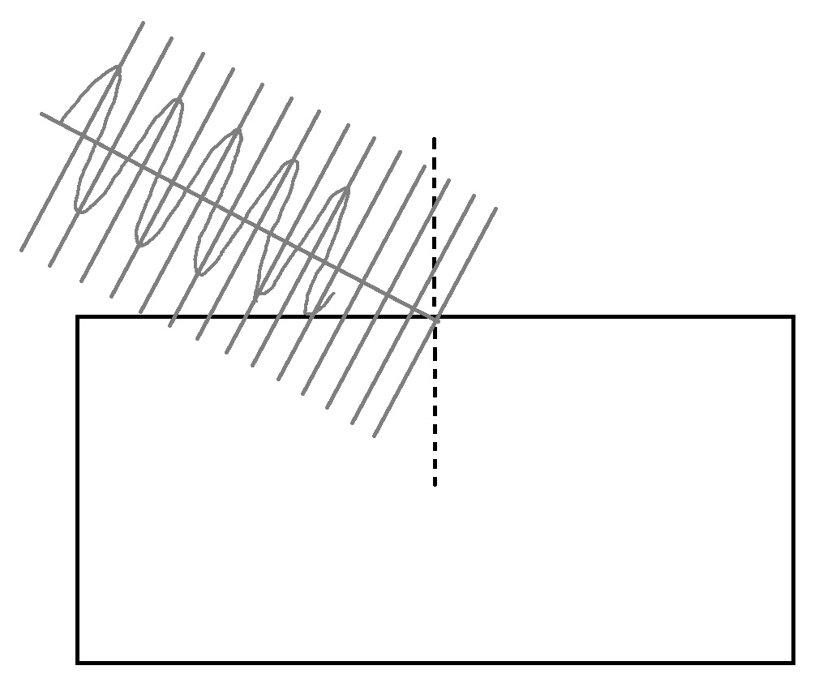
Essential Waves TASK
WORK OUT THE ANSWERS!
Recall the wave equation that links wavelength, frequency and wave speed and state the unit of each quantity.
Onto your copy of the diagram label a wavelength and the amplitude of the wave.
Describe what will happen to the wave speed as the wave progresses into the glass block from the surrounding air. Can you complete the sketch in as much detail as possible (pay attention to the wavelength)?
What is the name given to this phenomena - where a wave changes direction as a result of a change in wave speed? What other phenomena are associated with waves?
Going Deeper:
By referring to the diagram of a prism, can you describe how the wavelength of light affects the amount of refraction it experiences?
A traditional filament light bulb will emit a complete spectrum including electromagnetic waves outside of the visible region. How and where would you expect to detect these waves if this light was also passed through a prism?
Notes:
Set students approximately 10 minutes to complete the tasks on the slide and then peer review with the following slide.
You may want to proved students with a pre-printed version of the diagram.

Slide 20
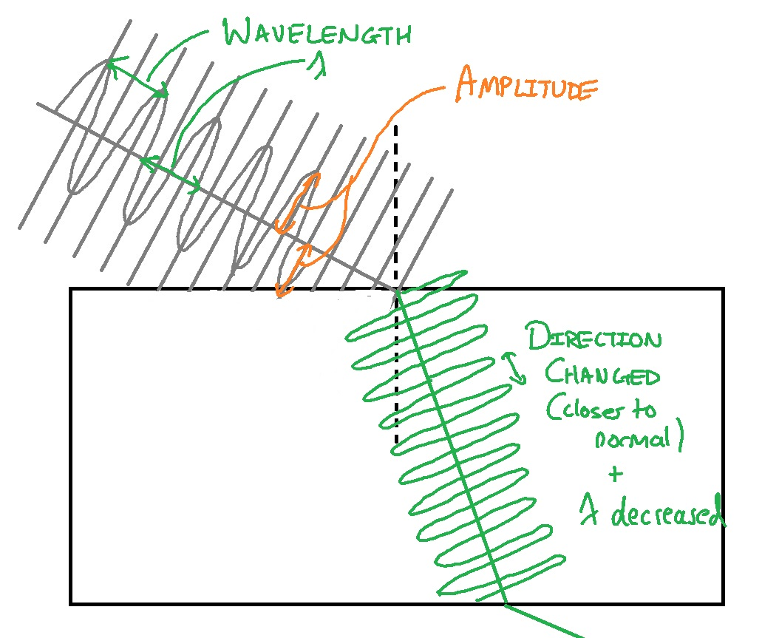
Essential Waves ANSWERS
1. Recall the wave equation that links wavelength, frequency and wave speed and state the unit of each quantity.
Wavespeed (m/s) = Frequency (Hz) X Wavelength (m)
2. Onto your copy of the diagram, label a wavelength and the amplitude of the wave. See diagram
3. Describe what will happen to the wave speed as the wave progresses into the glass block from the surrounding air. Can you complete the sketch in as much detail as possible (pay attention to the wavelength)? See diagram - speed decreased, wavelength decreases
4. What is the name given to this phenomena - where a wave changes direction as a result of a change in wave speed? What other phenomena are associated with waves?
Refraction (shown in diagram), Reflection, Diffraction and Polarisation (going deeper)

