Slide 1
Y11 Thinking about A Level Biology!
Welcome to presentation 2!
What to expect from these resources:
A taste of what the content will look like
Clear structure to prepare for learning next year and help you “Bridge the Gap” from GCSE to A Level!
Learning goal | What is A Level Biology About?!
Prior knowledge | Combined or Triple Biology
Application | Begin to prepare for the transition from GCSE to A Level using independent study resources

Slide 2
Presentation 2:
Essential Knowledge
for A Level Biology

Slide 3
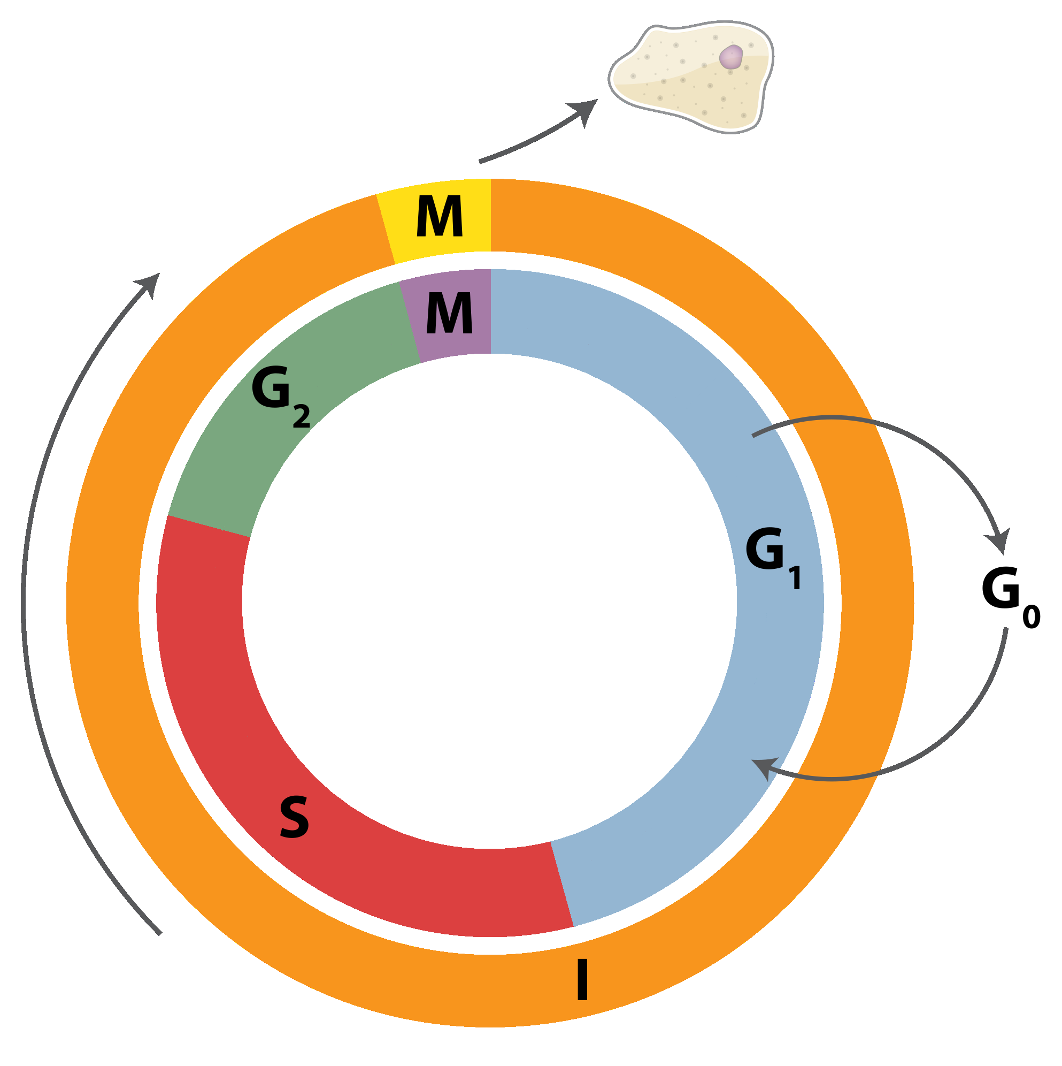
Essential Cell Division & Reproduction
Cell division and reproduction are used to explain a wide range of applications in Biology including reproduction, antibiotic resistance and inheritance.
Throughout AS and A2 Biology you will be required to use and apply this knowledge.
Hint:
If you didn’t watch this in presentation 1, you might want to now:
https://www.youtube.com/watch?v=QVCjdNxJreE
Notes:
Introduce cell division and reproduction as one of the foundations of knowledge for AS and A2 biology. Make connections between learning at GCSE and where this knowledge will be used and applied both in context and in unfamiliar contexts for your specification.

Slide 4
Essential – The Cell Cycle TASK
The cell cycle describes the stages that all dividing cells pass through.
The majority of time is spent in interphase. During interphase cells grow, new organelles and cell proteins are made and the DNA of the cell is replicated.
The progression of the cell cycle is controlled by tumour suppressor and oncogenes. These can be used to explain the development of cancers.
Task:
Explain what happens to the cell at M on the diagram.
Notes:
Explain to students that cells spend most of their time in interphase and only a small percentage of time actually dividing. Make links to the appropriate areas of your specification, including where this knowledge is required to explain other concepts, for example cancers, tumour suppressor genes and oncogenes.

Slide 5
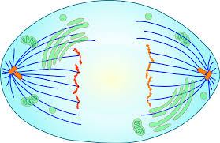
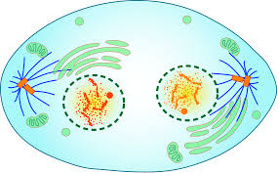
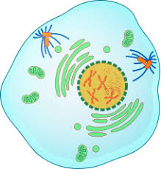
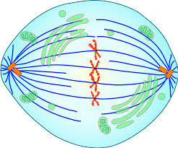
Essential - Mitosis TASK
A B C D
You must be able to identify and describe the appearance of cells undergoing mitosis. Examiners may use diagrams or micrographs to test this knowledge.
Task:
Put the diagrams in order
Identify the stage that each cell is undergoing and explain why you have made this choice.
Notes:
C Prophase: The chromosomes condense, becoming shorter and fatter and visible. Spindle fibres begin to form.
The nuclear envelope breaks down and the chromosomes become free in the cytoplasm.
D Metaphase: The chromosomes which are made up from two chromatids, line up along the equator of the cell.
The chromosomes attach to spindle fibres by their centromeres.
A: Anaphase: The chromosomes divide at the centromere separating the sister chromatids. The spindle fibres contract and the chromatids are pulled to the opposite poles of the cell.
B: Telophase: The chromatids have reached the poles of the cell. They uncoil and become long and thin (now known as chromosomes). A nuclear envelope forms around each set of chromosomes. The cell splits into two in a process called cytokinesis.

Slide 6
Essential - Mitosis TASK
A B C D
1
Prophase: The chromosomes condense, becoming shorter and fatter and visible. Spindle fibres begin to form.
The nuclear envelope breaks down and the chromosomes become free in the cytoplasm.

Slide 7
Essential - Mitosis TASK
A B C D
2
Metaphase: The chromosomes which are made up from two chromatids, line up along the equator of the cell.
The chromosomes attach to spindle fibres by their centromeres.
Notes:
.

Slide 8
Essential - Mitosis TASK
A B C D
3
Anaphase: The chromosomes divide at the centromere separating the sister chromatids. The spindle fibres contract and the chromatids are pulled to the opposite poles of the cell.

Slide 9
Essential - Mitosis TASK
A B C D
4
Telophase: The chromatids have reached the poles of the cell. They uncoil and become long and thin (now known as chromosomes). A nuclear envelope forms around each set of chromosomes. The cell splits into two in a process called cytokinesis.
Notes:
B:

Slide 10
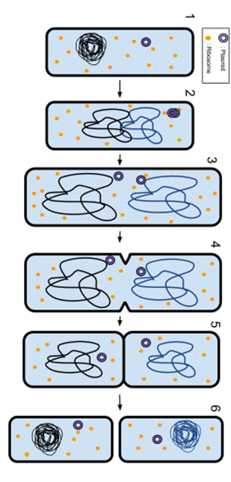
Essential - Binary Fission TASK
Binary fission is how bacteria reproduce.
Task:
Describe how binary fission is similar and different to meiosis.
Hint:
Use a table or a Venn diagram in order to do this.
Recall knowledge from last session or watch this:
https://www.youtube.com/watch?v=Pxujitlv8wc
Notes:
.

Slide 11
Essential - Binary Fission
The DNA and plasmids in a prokaryote are replicated.
The prokaryote then splits into two new cells. The new cells contain some of the original DNA as well as copies of each of the plasmids.
Bacteria can transfer genetic information vertically (i.e. between generations) and horizontally (i.e. within generations). This greatly enhances their ability to share advantageous alleles and mutations.

Slide 12
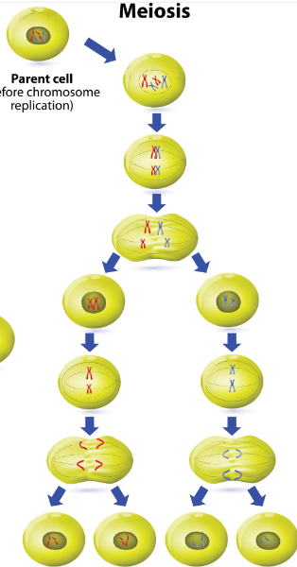
Essential - Meiosis TASK
2n
homologous chromosomes
pair up
Meiosis I
Meiosis is another form of cell division.
Task:
Summarise the similarities and differences between mitosis and meiosis.
n
Meiosis II
Hint:
Use a table or a Venn diagram in order to do this.
Recall knowledge from last session or watch this:
https://www.youtube.com/watch?v=qH4WUUQ5pOI
Notes:
Challenge students to compare and contrast mitosis and meiosis. Students could use a table or a Venn diagram in order to do this. This is a good opportunity to check that students are using keywords appropriately.

Slide 13
Essential - Meiosis
2n
Cells undergoing meiosis pass through prophase, metaphase, anaphase and telophase twice. Remember to describe both phases as you can be credited twice for the same information!
Four, genetically unique, daughter cells are formed that are gametes, e.g. sperm or ova.
These cells are unique due to:
Independent segregation
Cross over of homologous pairs
Mutation
homologous chromosomes
pair up
Meiosis I
Don’t worry too much about how these three create the genetic variation right now, they are tricky and we will go over them together!
n
Meiosis II

Slide 14
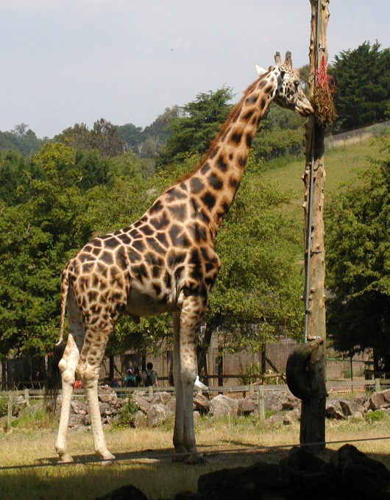
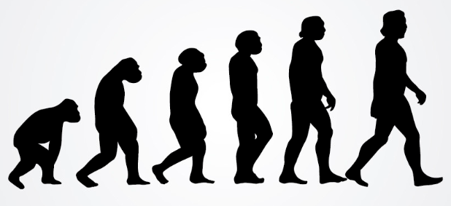
Essential - Inheritance & Evolution TASK
Inheritance builds on your knowledge of this topic from GCSE. It requires a more detailed answer at A Level including some key terms.
Task:
Write down the process of evolution by natural selection. (You might want to use an example such as giraffes, antibiotic resistant bacteria, or the peppered moth).
Notes:
Challenge students to recall and use their knowledge of evolution by natural selection from GCSE. You may need to remind them of Darwin’s work (and possibly of the contrasting views of Lamarck). Encourage them to write a fully detailed description of this process. They could use an example if this supports their writing.

Slide 15
Essential - Inheritance & Evolution
How many of the following points and key terms did you include?
Populations show genetic diversity
Random mutation can result in new alleles of a gene appearing
If the new allele is advantageous, this could lead to increased reproductive success (i.e. the organism survives, reaches maturity and reproduces)
The advantageous allele is inherited by the next generation
The new allele increases in frequency within the population over many generations.
This leads to species that are better adapted to their environment either anatomically, physiologically or behaviourally.
Notes:
Enc

Slide 16
Going Deeper
Neurones normally remain in G0 of the cell cycle where they do not replicate or divide.
Alzheimer’s disease is a disease effecting neurones in the brain. Scientists think that in Alzheimer’s, cells incorrectly re-enter the cell cycle but lose the ability to regulate cell death (apoptosis). This results in a build up of proteins that lead to further symptoms of the disease.
Use this information to suggest why spinal cord injuries are very difficult to treat.
99% of Alzheimer’s disease is not inherited. Use your knowledge of meiosis and the cell cycle to suggest an explanation for this.
Suggest what a healthy sample of neurone cells would look like under a light microscope (you may use a sketch if you wish).
Suggest how anti-cancer therapies could prove useful in the treatment of Alzheimer’s disease.
Notes:
The information states that neurones do not normally divide or replicate, hence students should deduce that the body lacks the ability to repair or replace damaged neurones in the spine.
Alzheimer’s is most often caused by a fault in the regulation of the cell cycle (specifically this is thought to be due to oxidative stress placed upon the neuronal cells in questions and hence is correlated with life-style, head injury etc). For it to be an inherited disease, a faulty allele would need to be passed on during meiosis. A parent would need to at least be a carrier of this condition, or a sufferer. Encourage students to reflect on their prior learning of conditions including CF and Huntington’s from the GCSE specifications in order to develop their understanding of this.
Students should demonstrate an understanding that healthy neurones would appear to be in interphase of the cell cycle. Use this as an opportunity to revisit PMAT.
Anti-cancer therapies target cells that are undergoing division, therefore these treatments could target the neurones that are incorrectly dividing. Students could be challenged to extend this thinking to include some of the potential risks or side effects that would accompany this treatment.

