Slide 1
Y11 Thinking about A Level Physics!
Welcome to presentation 3!
What to expect from these resources:
A taste of what the content will look like
Clear structure to prepare for learning next year and help you “Bridge the Gap” from GCSE to A Level!
Learning goal | What is A Level Physics About?!
Prior knowledge | Combined or Triple Physics
Application | Begin to prepare for the transition from GCSE to A Level using independent study resources

Slide 2
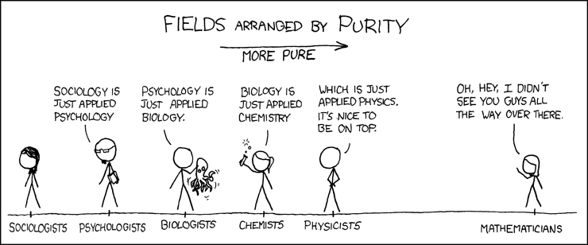
Y11 Thinking about A Level Physics!
Welcome to presentation 2!
What to expect from these resources:
This will give you a really clear idea of some of the maths skills you will need
This will not come as a surprise – there is a lot of maths, some might argue Physics is actually applied Maths. You need to be confident applying your skills

Slide 3
Presentation 3:
Essential Mathematics
for A Level Physics

Slide 4
Essential Maths
At least 40% of the marks in the examinations will require the use of mathematical skills.
Standard form, prefixes and significant figures.
You need to be able to use standard form and recognise common prefixes.
Calculate the following and express your answer in standard form and as an ordinary number:
(2.02 x 10⁴) x (3.50 x 10²) b) 5.2 x 10⁻² / 1.4 x 10³ c) 0.002750 + 4.20 x 10⁻³
2) Calculate the following, express your answer in standard form in SI units (m²).
a) 5.6cm x 7.1nm b) 9.3mm x 2.4Mm c) 3.1 μm x 1.6Gm
WORK OUT THE ANSWERS!
Notes:
Not all these prefixes will have been used at GCSE. If students don’t already know this they could refer to the table in the gateway booklet.

Slide 5
Standard form, prefixes and significant figures
1a) 7.1 x 10⁶ or 7 100 000
b) 3.7 x 10⁻⁵ or 0.000037
c) 6.95 x 10⁻³ or 0.00695
2a) 4.0 x 10⁻¹⁰ m²
b) 2.2 x 10⁴ m²
c)4.3 x 10³ m²
Remember that all answers should be given to the same number of significant figures as the question. You can never be more precise than the data you are given, but round at the end of a multistep calculation to avoid rounding errors.

Slide 6
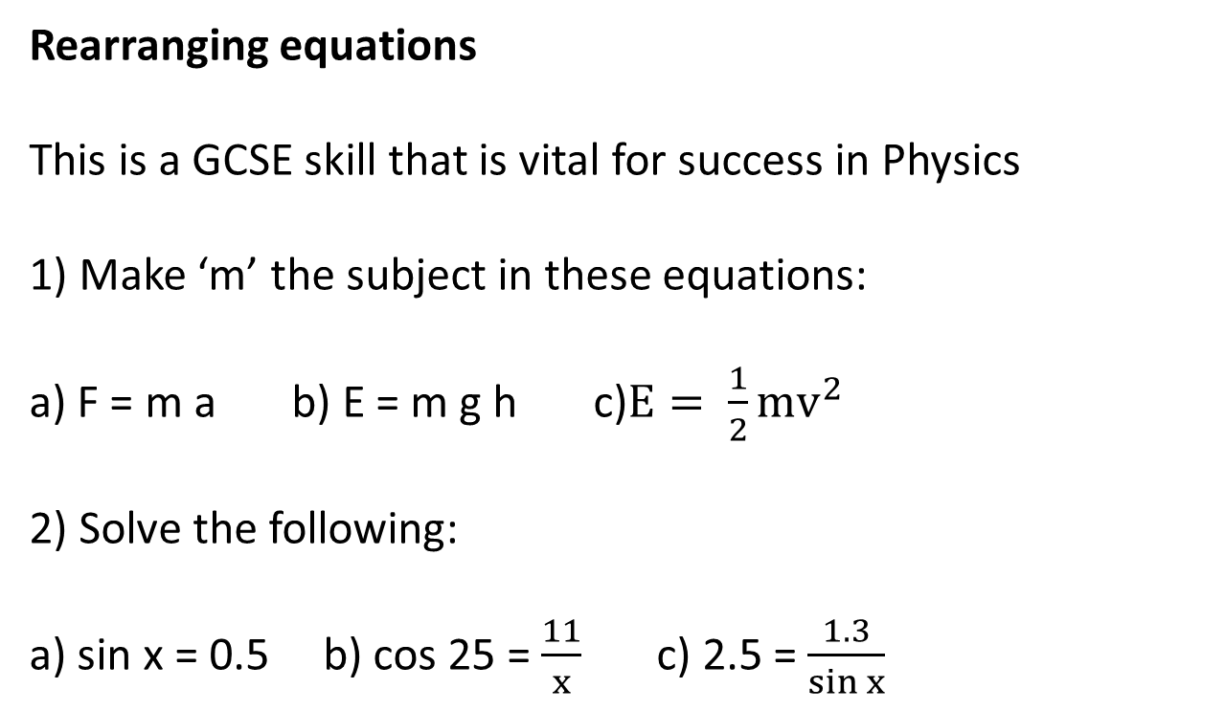
Hint:
https://www.youtube.com/watch?v=8Z8jUW03z3s
WORK OUT THE ANSWERS!
Rearranging equations
This is a GCSE skill that is vital for success in Physics
1) Make ‘m’ the subject in these equations:
a) F = m a b) E = m g h c)$E= \frac{1}{2}mv^{2}$
2) Solve the following:
a) sin x = 0.5 b) cos 25 = $\frac{11}{x}$ c) 2.5 = $\frac{1.3}{\sin{x}}$
Going deeper:
Rearrange to find ‘a’:
v² = u² + 2as
s = ut + ½ at²
Beyond expected knowledge:
What does ‘x’ equal?
4 = 10^{x}
Notes:
From this task you could identify any students that will need maths support as they will struggle with the beginnings of A level Physics if they cannot do question 1.

Slide 7
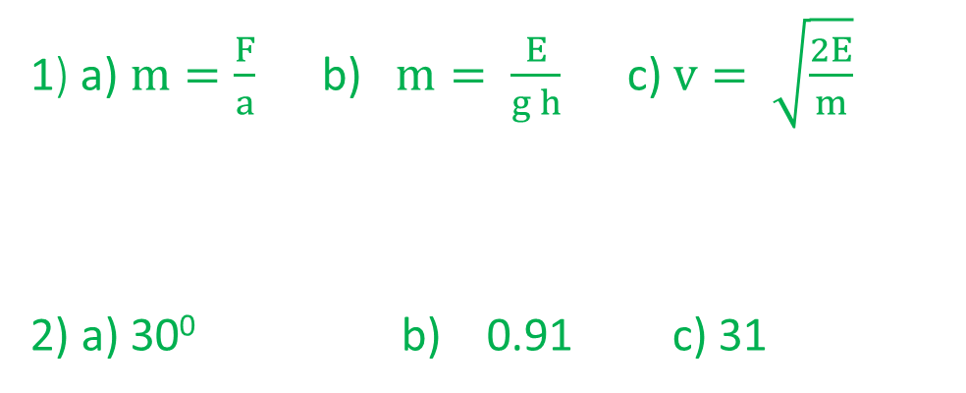
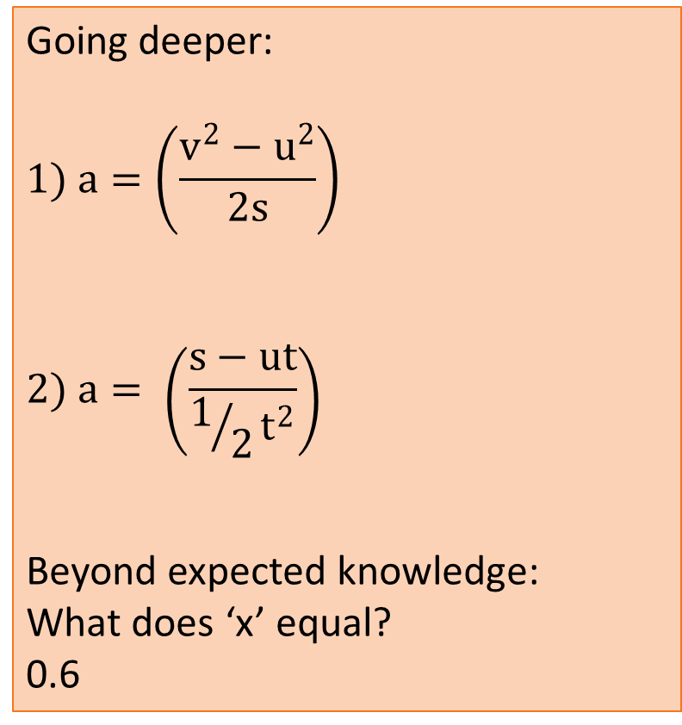
Rearranging equations
Going deeper:
$$1) a=\left(\frac{v^{2}−u^{2}}{2s}\right)$$
$$2) a= \left(\frac{s−ut}{1/2t^{2}}\right)$$
Beyond expected knowledge:
What does ‘x’ equal?
0.6
1) a) $m=\frac{F}{a}$ b) $m= \frac{E}{g h}$ c) $v= \sqrt{\frac{2E}{m}}$
2) a) 30⁰ b) 0.91 c) 31
Notes:
Beyond expected knowledge – correct answer comes from use of logarithms. Students can look into this in their own time or you can discuss estimations at this point.

Slide 8
WORK OUT THE ANSWERS!
Trigonometry
Find, by calculation or scale drawing,
the length of side ‘x’
the angle ‘y’
2) Find, by calculation or scale drawing,
the length of side ‘A’
the length of side ‘B’
A
x
5cm
14km
B
y
32⁰
7cm
Going deeper: How would your answers change if:
in Q1 the length of the shortest side doubled?
in Q2 the angle halved?
Notes:
Both methods can be used at A level however calculations should be encouraged.

Slide 9
Trigonometry
1a) x² = 5²+7²
x = 8.6cm
b) the angle ‘y’ = 36⁰
2a) sin32=A/14
A= 7.4km
b) B = 12km
A
x
5cm
14km
B
y
32⁰
7cm
Extension: 1a) 12cm b) 55⁰ 2a)3.9km b) 13km

Slide 10
WORK OUT THE ANSWERS!
Geometry
Calculate the area of the shapes below. (Going deeper: convert answers to m²)
6cm
4km
7cm
6cm
2cm
5km
8cm
10cm
Calculate the circumference and area of the circles below
7cm
13m
Notes:
Formulas for circles is given on the data sheet

Slide 11
6cm
Geometry
4km
7cm
6cm
2cm
2cm
5km
8cm
10cm
24 cm²
2.4 x 10⁻³ m²
10 km²
1 x 10⁷ km²
56cm²
5.6 x 10⁻³ cm²
Calculate the circumference and area of the circles below
22cm
38cm²
41m
130m²
7cm
13m

Slide 12
WORK OUT THE ANSWERS!
Units
You need to use correct units in calculations and convert units. Below are the five ‘base’ or S.I units you will use this year. You need to be able to convert and recognise units in S.I units
Quantity | S.I Unit
electric current | A
temperature | K
time | s
length | m
mass | kg
1) Force = Change in momentum/time
Write the unit for Force, Newtons, in S.I units
2) Convert 10km/hour into S.I units
3) Kinetic energy can be calculated using $E= \frac{1}{2}mv^{2}$
Write the unit for energy, Joules, in S.I units
4) Which of these is a correct unit of power?
a) Js b) kgm⁻¹s⁻² c) Nm d) kg m² s⁻³
Going deeper: Write down as many different units for a) energy and b) power as you can

Slide 13
Units
Write the unit for Force, Newtons, in S.I units kg ms^{–2}
2) Convert 10km/hour into S.I units 2.8m/s
10 000m/hour = 166.67m/minute = 2.8m/s
3) Write the unit for energy, Joules, in S.I units kg m²s⁻⁴
4) Which of these is a correct unit of power?
a)Js b) kgm⁻¹s⁻² c) Nm d) kg m² s⁻³

