Slide 1
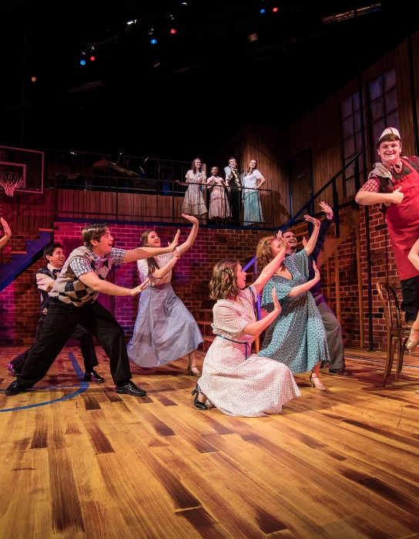
Btec Performing Arts

Slide 2
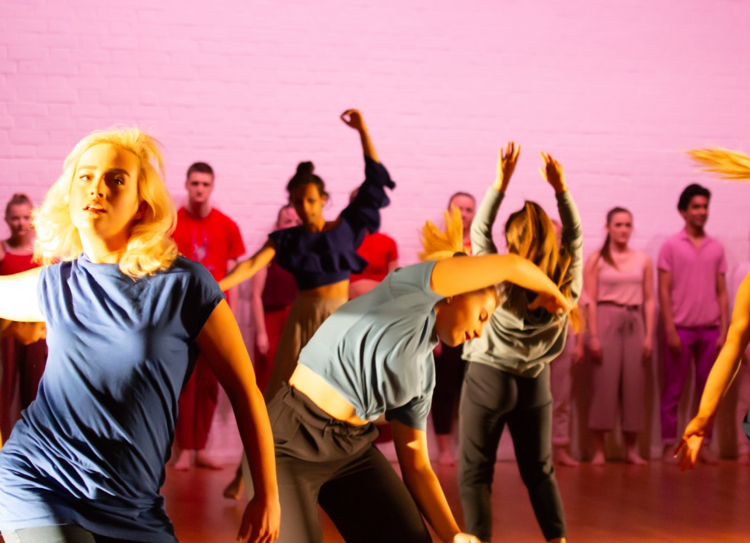
COURSE INFORMATION:
Equivalent to 1 A Level
4 units across the 2 years
3 are compulsory, of those 3, 1 is an internal unit. The other 2 are external and are set by Pearson.
The last unit is an optional unit and is usually selected to meet the strengths and interests of the cohort.
Each unit has a set of assessment outcomes that you must meet.
Units are marked using Pass, Merit, Distinction depending on the quality of the work.
Units are completed throughout the year rather than a large exam at the end. Once a unit is complete, we do not revisit it.

Slide 3
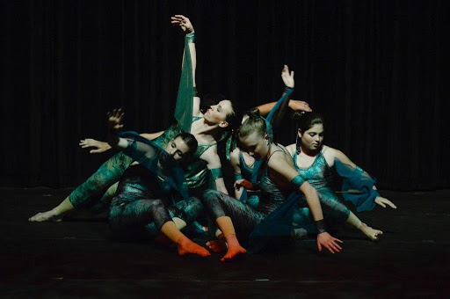
THE UNITS:
COMPULSORY: | OPTIONAL:
Unit 1: Investigating Practitioners Work | Unit 8: Classical Ballet Technique
Unit 2: Developing Skills and Techniques for Live Performance | Unit 9: Tap Dance Technique
Unit 3: Group Performance Workshop | Unit 10: Jazz Dance Technique
 | Unit 11: Street Dance Technique
 | Unit 12: Contemporary Dance Technique
 | Unit 18: Interpreting Classical Text For Performance
 | Unit 19: Acting Styles
 | Unit 20: Developing the Voice for Performance
 | Unit 21: Improvisation
 | Unit 22: Movement for Performance

Slide 4
COURSE OVERVIEW
 | YEAR 12 | YEAR 13
AUTUMN TERM 1 | Workshops on Practitioners | Optional Unit
AUTUMN TERM 2 | Unit 2: Developing Skills | Optional Unit
SPRING TERM 1 | Unit 2: Devising Performance | Optional Unit
SPRING TERM 2 | Unit 2: Performance and Finishing Coursework Unit 1 : Prep | Unit 3: Prep
SUMMER TERM 1 | Unit 1 | Unit 3
SUMMER TERM 2 | Unit 1 | Unit 3

Slide 5
OVER THE SUMMER:
Revisit and/ or introduce yourself the practitioners that we may look at in the Autumn Term on the following slides.
Have a go at the following techniques from Frantic assembly: https://www.youtube.com/playlist?list=PLSsD8q4apPcVjna9-vZgyuHp04HK8cdRV
Using the stimulus of a book write a proposal for a performance this could be in the form of Dance, Drama or Physical Theatre. You should include information about the style of the piece, location and artistic intentions.

Slide 6
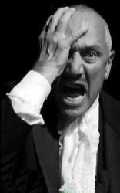
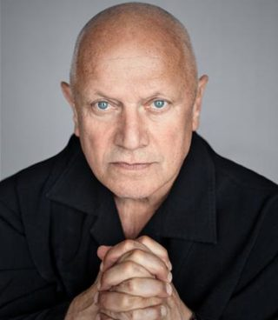
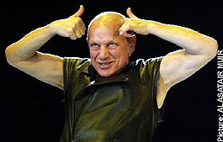
STEVEN BERKOFF
http://www.iainfisher.com/berkoff/steven-berkoff.html

Slide 7
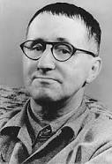
BERTOLT BRECHT

Slide 8
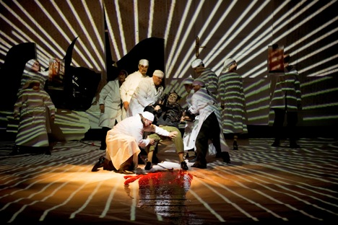
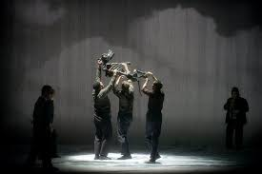
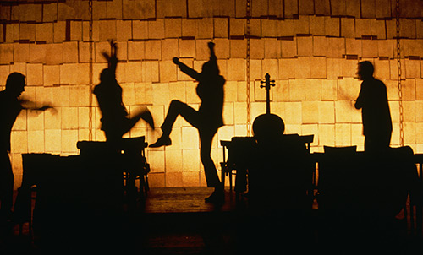
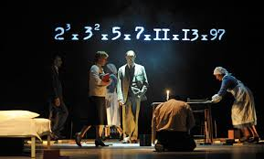
COMPLICITE
http://www.complicite.org/

Slide 9
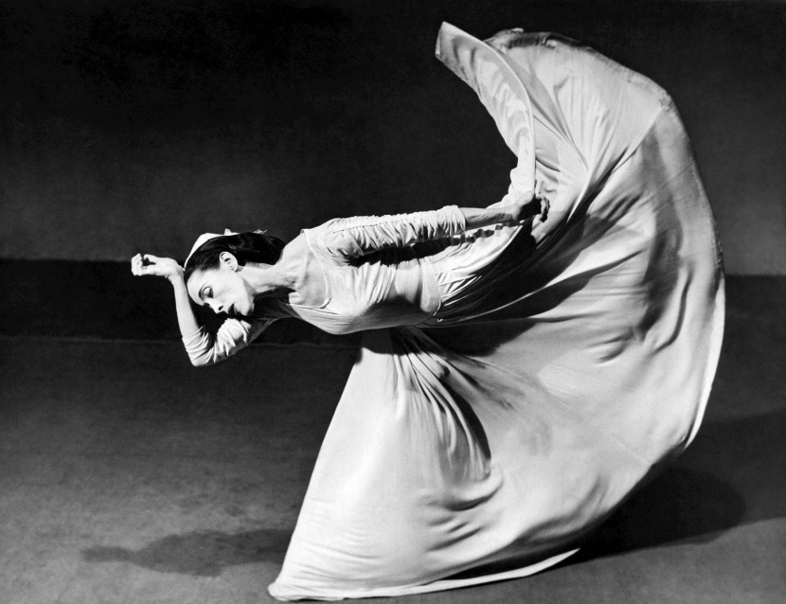
Practitioners that we may look at:
Martha Graham: https://marthagraham.org/history/

Slide 10
Practitioners that we may look at:
Christopher Bruce: https://www.rambert.org.uk/performance-database/people/christopher-bruce/

Slide 11
Practitioners that we may look at:
Akram Khan: https://www.akramkhancompany.net/company-profiles/akram-khan/

Slide 12
Practitioners that we may look at:
Matthew Bourne: https://new-adventures.net/profile/sir-matthew-bourne-obe#overview

Slide 13
Practitioners that we may look at:
DV8 Physical Theatre: https://www.dv8.co.uk/about-dv8/lloyd-newson

Slide 14
Practitioners that we may look at:
Frantic Assembly: https://www.franticassembly.co.uk/the-frantic-method

Slide 15
Practitioners that we may look at:
Punchdrunk: https://www.punchdrunk.org.uk/about-us/

Slide 16
Practitioners that we may look at:
Kneehigh: https://www.kneehigh.co.uk/about/history/

