Slide 1
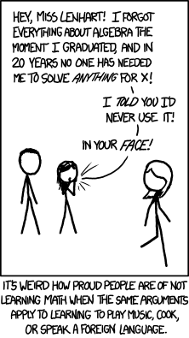
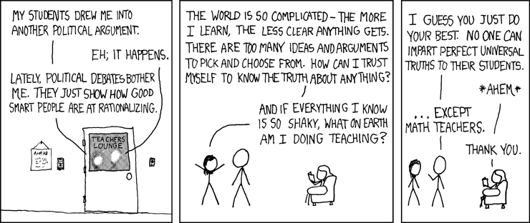

Slide 2
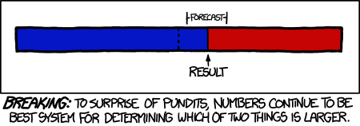
What courses are on offer?
GCSE Mathematics re-sit
Core
Maths
AS and A level Mathematics
AS and A level Further Mathematics

Slide 3
Numeracy and maths at University
Surveyed staff and students in seven subject areas at university: business, chemistry, computing, economics, geography, sociology and psychology
“Many students arrive at university with unrealistic expectations of the mathematical and statistical demands of their subjects. Lack of confidence and anxiety about Mathematics/Statistics are problems for many students.”

Slide 4
Numeracy and maths at University
Students struggle with apparently elementary ideas and methods that staff expect them to cope with easily
Students struggle to apply techniques and methods to new problem areas, even when on the face of it the techniques and methods are ones they know well.
Students appear to have been trained to answer certain kinds of problems, but become lost when the same knowledge is needed in unfamiliar contexts.

Slide 5
Level 3 Mathematical Studies (Core Maths)
AQA Level 3 Certificate in Mathematical Studies
Equivalent to 1 AS (or the EPQ)
Taken over 2 years
Focus on application of known techniques
Paper 1 | Compulsory content | 1 hour, 30 minutes | 60 marks (50%)
Paper 2 | Critical analysis of data and one of: Statistical techniques Critical path and risk analysis Graphical techniques | 1 hour, 30 minutes | 60 marks (50%)

Slide 6
Level 3 Mathematical Studies (Core Maths)
Compulsory Content
2A Statistical techniques
The normal distribution
2B Critical path & risk analysis
2C Graphical techniques
Analysis of data
Maths for personal finance
Estimation
Critical analysis of given data*
Correlation and regression
Critical path analysis
Expectation
Cost benefit analysis
Graphical methods
Rates of change
Exponential functions
*Critical analysis is examined in the first section of each Paper 2

Slide 7
AQA Level 3 Mathematical Studies Paper 1, June 2017

Slide 8
What can I do with Core Maths?
Still quite new so not a requirement for any higher or further education courses yet
But it does make your application more desirable for the following:
Accounting
Architecture
Biology
Business
Chemistry
Finance
Management
Marketing
Medicine
Psychology
Social sciences
6/B+ at GCSE, but 5/Cs considered case by case

Slide 9
AS/A Level Mathematics
Most popular AS/A level in England
Russell Group “facilitating subjects”
AS Maths
Paper 1 | Pure Mathematics | 2 hours | 100 marks (62.5%)
Paper 2 | Statistics & Mechanics | 1 hour, 15 minutes | 60 marks (37.5%)
A Level Maths
Paper 1 | Pure Mathematics 1 | 2 hours | 100 marks (33.33%)
Paper 2 | Pure Mathematics 2 | 2 hours | 100 marks (33.33%)
Paper 3 | Statistics and Mechanics | 2 hours | 100 marks (33.33%)

Slide 10
AS/A Level Mathematics
Most popular AS/A level in England
Russell Group “facilitating subjects”
Usually required for:
Actuarial Science
Engineering
Computing
Economics
Mathematics
Physics
“Desirable” for:
Accountancy
Architecture
Biology
Business & Management
Dentistry
Environmental Science/Conservation
Geography
Materials Science
Philosophy
Psychology
Usually not required for biochemistry, biomedical sciences, geology, medicine, pharmacy, sports science and veterinary science, if you are studying physics.
7/A+ at GCSE, but 6/Bs considered case by case

Slide 11
AS Mathematics Content
Pure Maths
Proof
Statistics
Mechanics
Algebra & functions
Coordinate geometry
Sequences and series
Trigonometry
Exponentials & logarithms
Differentiation
Integration
Vectors
Statistical sampling
Data presentation & interpretation
Probability
Statistical distributions
Hypothesis testing
Quantities and units in mechanics
Kinematics
Forces & Newton’s Laws

Slide 12
A Level Mathematics Content
Pure Maths
Proof
Statistics
Mechanics
Algebra & functions
Coordinate geometry
Sequences and series
Trigonometry
Exponentials & logarithms
Differentiation
Integration
Vectors
Statistical sampling
Data presentation & interpretation
Probability
Statistical distributions
Hypothesis testing
Quantities and units in mechanics
Kinematics
Forces & Newton’s Laws
Moments

Slide 13
Edexcel Sample Assessment Materials
AS Mathematics: Paper 1

Slide 14
Edexcel Sample Assessment Materials
AS Mathematics: Paper 1

Slide 15
Edexcel Sample Assessment Materials
AS Mathematics: Paper 2

Slide 16
Edexcel Sample Assessment Materials
AS Mathematics: Paper 2

Slide 17
AS/A Level Further Mathematics
Rigorous course for serious mathematicians
Designed for students wishing to study maths or closely related subjects at university
AS Further Maths
Paper 1 | Core Pure Mathematics | 1 hour, 40 minutes | 80 marks (50%)
Paper 2 | Further Mathematics Options: Two of: Further Pure 1 Further Pure 2 Further Mechanics 1 Further Mechanics 2 Further Statistics 1 Further Statistics 2 Decision Maths 1 Decision Maths 2 | 1 hour, 40 minutes | 80 marks (50%)

Slide 18
AS Further Mathematics Content
Core Pure Maths
Proof
Further Pure Mathematics 1
Further trigonometry
Complex numbers
Matrices
Further algebra & functions
Further calculus
Further vectors
Conic sections
Further vectors
Numerical methods
Inequalities
Further Pure Mathematics 2
Group theory
Further matrices
Further complex numbers
Number theory
Further sequences and series
Further Statistics 1
Discrete probability distributions
Chi squared tests
Further Statistics 2
Linear regression
Continuous probability distributions
Correlation
Further Mechanics 1
Momentum & impulse
Work, energy& power
Collisions
Further Mechanics 2
Circular motion
Centres of mass
Further kinematics
Decision Mathematics 1
Algorithms
Graph theory
Algorithms applied to graphs
Critical path analysis
Linear programming
Decision Mathematics 2
Allocation problems
Network flows
Game theory
Recurrence relations

Slide 19
AS/A Level Mathematics
A Level Further Maths
Paper 1 | Core Pure Mathematics 1 | 1 hour, 30 minutes | 75 marks (25%)
Paper 2 | Core Pure Mathematics 2 | 1 hour, 30 minutes | 75 marks (25%)
Paper 3 | Further Mathematics Option 1: One of: Further Pure 1 Further Mechanics 1 Further Statistics 1 Decision Maths 1 | 1 hour, 30 minutes | 75 marks (25%)
Paper 4 | Further Mathematics Option 2: One of: FP2, FM1, FM2, FS1, FS2, DM1, DM2 | 1 hour, 30 minutes | 75 marks (25%)

Slide 20
A Level Further Mathematics Content
Core Pure Maths
Extensions to AS content, plus:
Further Pure Mathematics 1
Extensions to AS content, plus:
Further Pure Mathematics 2
Extensions to AS content, plus:
Further Statistics 1
Extensions to AS content, plus:
Further Statistics 2
Extensions to AS content, plus:
Further Mechanics 1
Extensions to AS content, plus:
Further Mechanics 2
Extensions to AS content, plus:
Decision Mathematics 1
Extensions to AS content, plus:
Decision Mathematics 2
Extensions to AS content, plus:
Polar coordinates
Hyperbolic functions
Differential equations
Further differential equations
Further calculus
Further calculus
Geometric & negative binomial probability distributions
Hypothesis testing
Central Limit Theorem
Probability generating functions
Combinations of random variables
Estimations and confidence intervals
Hypothesis tests using the t-distribution
Elastic springs and energy
Oblique impacts
Further centres of mass
Further dynamics
The Travelling Salesman Problem
The Simplex algorithm
Transportation problems
Dynamic programming
Decision analysis

Slide 21
Edexcel Sample Assessment Materials
AS Further Mathematics: Paper 1

