Slide 1
Y11 Thinking about A Level Chemistry!
Welcome to presentation 2!
What to expect from these resources:
A taste of what the content will look like
Clear structure to prepare for learning next year and help you “Bridge the Gap” from GCSE to A Level!
Learning goal | What is A Level Chemistry About?!
Prior knowledge | Combined or Triple Chemistry
Application | Begin to prepare for the transition from GCSE to A Level using independent study resources

Slide 2
Presentation 2:
Essential Knowledge
for A Level Chemistry

Slide 3
Rusty on bonding?
Start here:
https://www.youtube.com/watch?v=QXT4OVM4vXI

Slide 4
Ionic bonding
Ionic bonds form between metals and non-metals. Ionic bonding involves the transfer of electrons in the outer shells.
Metals lose electrons to become positively charged ions.
Non-metals gain electrons to become negatively charged ions.
Given the charges opposite, write down the formula of the following compounds:
Sodium chloride
Sodium oxide
Magnesium chloride
Aluminium oxide
Sodium carbonate
Magnesium nitrate
WORK OUT THE ANSWER!
Notes:
The questions in the orange box can be used as a starter activity and peer/self assessed when completed.

Slide 5
Ionic bonding
Ionic bonds form between metals and non-metals. Ionic bonding involves the transfer of electrons in the outer shells.
Metals lose electrons to become positively charged ions.
Non-metals gain electrons to become negatively charged ions.
Given the charges opposite, write down the formula of the following compounds:
Sodium chloride
Sodium oxide
Magnesium chloride
Aluminium oxide
Sodium carbonate
Magnesium nitrate
NaCl
Na₂O
MgCl₂
Al₂O₃
Na₂CO₃
Mg(NO₃)₂
Notes:
The questions in the orange box can be used as a starter activity and peer/self assessed when completed.

Slide 6
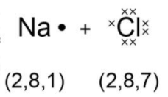
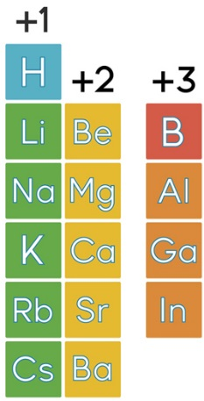
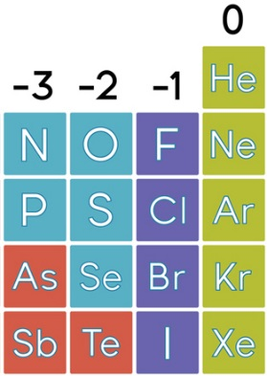
Ionic bonding
The electrostatic attraction between the oppositely charged ions is called ionic bonding.
The electron transfer during the formation of an ionic compound can be represented by a dot and cross diagram:
Draw dot and cross diagrams for:
Sodium oxide
Magnesium chloride
WORK OUT THE ANSWER!
Charges of simple ions can be
predicted using the position
in the periodic table.
Why do atoms gain or lose electrons?
WORK OUT THE ANSWER!
Notes:
Give pupils five minutes to draw the two dot and cross diagrams. Swap with partners can anything be improved or changed?

Slide 7
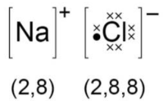
Ionic bonding
The electrostatic attraction between the oppositely charged ions is called ionic bonding.
The electron transfer during the formation of an ionic compound can be represented by a dot and cross diagram:
Draw dot and cross diagrams for:
Sodium oxide
Magnesium chloride
Charges of simple ions can be
predicted using the position
in the periodic table.
Why do atoms gain or lose electrons?
To achieve the stable electronic structure of a noble gas.
Notes:
Give pupils five minutes to draw the two dot and cross diagrams. Swap with partners can anything be improved or changed?

Slide 8
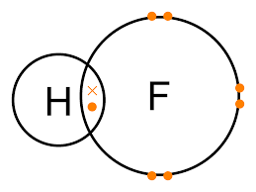
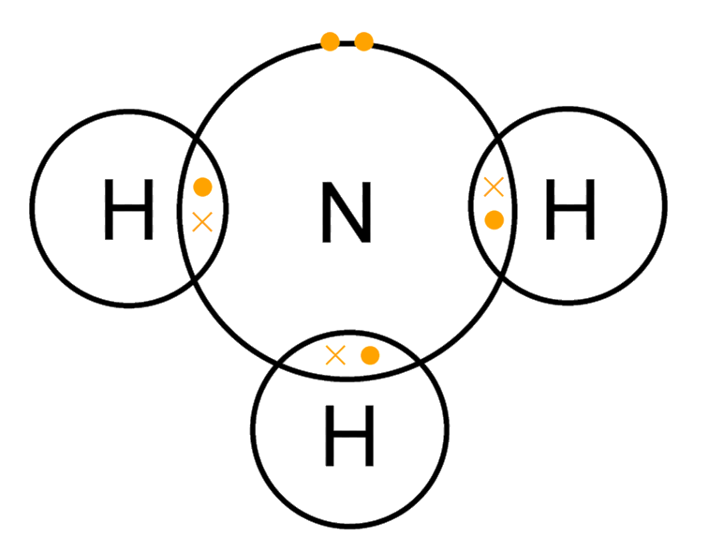
Covalent bonding
Covalent bonds form between non-metals. Covalent bonding is a shared pair of electrons in the outer shells.
Therefore a single bond is one shared pair of electrons, a double bond is two shared pairs of electrons etc.
Covalent bonding happens because the electrons are more stable when attracted to two nuclei than when attracted to only one.
Covalent bonds should not be regarded as shared electron pairs in a fixed position; the electrons are in a state of constant motion and are best regarded more as charge clouds.
Notes:
Are students able to draw dot and cross diagrams for double covalent bonds and triple covalent bonds?

Slide 9
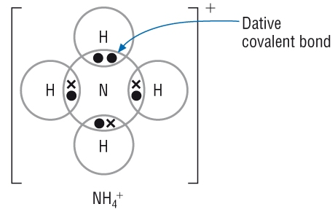
Hint:
https://www.youtube.com/watch?v=EWBoJi5xc70
Dative covalent bonds
A dative covalent bond (or coordinate bond) is a pair of electrons shared between two atoms, one of which provides both electrons to the bond.
In a dative covalent bond (or coordinate bond), one atom provides both electrons to the bond.
A dative covalent bond is represented by a short arrow from the electron providing both electrons to the electron providing neither.

Slide 10
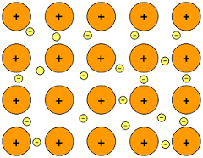
Metallic bonding
A metallic bond is an attraction between cations and a sea of electrons.
Metallic bonds are formed when atoms lose electrons and the resulting electrons are attracted to all the resulting cations.
Metallic bonding happens because the electrons are attracted to more than one nucleus and hence more stable. The electrons are delocalised – they are not attached to any particular atom but are free to move between the atoms.
Notes:
Ask students to use the diagram on this slide to explain why the melting and boiling points of metals increase across a period.

Slide 11
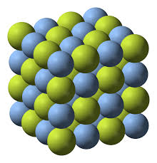
Ionic bonding – physical properties
Ionic bonds form a lattice. A lattice is an infinite and repeating arrangement of particles.
This structure contributes to the physical properties of ionic compounds.
Electrical Conductivity
Ionic compounds contain charged ions so they are able to move towards charged electrodes and will therefore conduct electricity.
In the solid state the ions are not free to move as they are tightly held in place. They do not conduct electricity.
In the liquid state, the ions are free to move and so can move towards their respective electrodes. Ionic compounds can conduct electricity in the liquid state.
Melting and boiling point
The attraction between opposite ions is very strong. A lot of kinetic energy is required to overcome them as the melting point and boiling point of ionic compounds is very high.
Mechanical properties
Since ions are held strongly in place by the other ions, they cannot move or slip over each other easily and are therefore hard and brittle.
Notes:
The next four slides refer to physical properties covered at GCSE. Ask students to work in pairs/small groups and come up with as many properties and explanations for each type of bonding as they can in ten minutes.

Slide 12
Metallic bonding – physical properties
Metallic bonding is the attraction between cations and a sea of delocalised electrons. The cations are arranged to form a lattice, with the electrons free to move between them.
Electrical Conductivity
Delocalised electrons are free to move throughout the crystal in a certain direction when a potential difference is applied. Metals therefore conduct electricity in the solid state. The delocalised electron system is still present in the liquid state, so metals can also conduct electricity well in the liquid state.
Melting and boiling point
Metallic bonding is relatively strong so the melting and boiling points of metals are relatively high.
Smaller ions, and those with a high charge, attract the electrons more strongly and so have higher melting points than larger ions with a low charge.
Mechanical properties
Metal cations can be moved around and there will still be delocalised electrons available to hold the cations together. The metal cations can therefore slip over each other fairly easily. As a result, metals tend to be soft, malleable and ductile.

Slide 13
Molecular covalent – physical properties
The molecules are held together by intermolecular forces, which are much weaker than covalent bonds but are often strong enough to keep the substance in the solid or liquid state. In the gaseous state, the intermolecular forces are broken but the bonds within the molecule remain intact - they are not broken. The gas phase consists of molecules, not atoms.
Melting and boiling point
These are generally low, since intermolecular forces are weak.
Intermolecular forces also decrease rapidly with increasing distance, so there is often little difference in the melting and boiling points.
Other physical properties
The intermolecular forces are weak and generally non-directional, so most molecular covalent substances are soft, crumbly and not very strong.
Electrical conductivity
There are no ions and no delocalised electrons, so there is little electrical conductivity in either solid or liquid state.

Slide 14
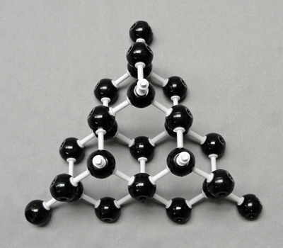
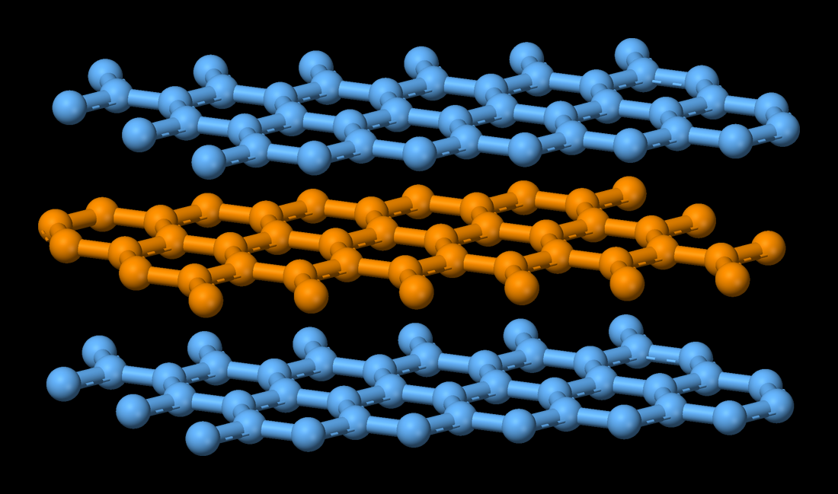
Giant covalent– physical properties
Diamond and silicon dioxide
Graphite
Melting and boiling point
Generally very high, since strong covalent bonds must be broken before any atoms can be separated.
Electrical conductivity
There are no ions or delocalised electrons, so there is little electrical conductivity in either solid or liquid state.
Other physical properties
Giant covalent substances are hard, strong and brittle.
Electrical conductivity
Due to the delocalised electrons, graphite is a very good conductor of electricity.
Density
Graphite has a much lower density than diamond due to the relatively large distances in between the planes.
Hardness
Much softer than diamond since the different planes can slip over each other fairly easily. This results in the widespread use of graphite in pencils and as an industrial lubricant.

Slide 15
Bond polarity
Electronegativity is the relative ability of an atom to attract electrons in a covalent bond.
Electronegativity increases across a period as the nuclear charge on the atoms increases but the shielding stays the same, so the electrons are more strongly attracted to the atom.
Electronegativity decreases down a group as the number of shells increases, so shielding increases and the electrons are less strongly attracted to the atom.
Electronegativity is very useful in predicting whether the bonding between two atoms will be ionic, covalent or metallic.

Slide 16
If both atoms have a similar electronegativity, they both attract the electrons with similar power so electrons will remain midway between the two. The bond will therefore be covalent - the electrons are shared between the two atoms.
x
H H
o
If one atom is significantly more electronegative than the other, it attracts the electrons more strongly than the other and the electrons are on average closer to one atom than the other. The electrons are still shared, but one atom has a slight deficit of electrons and a slight positive charge and the other a slight surplus of electrons and a slight negative charge. The bond is said to be polar covalent.
δ⁺
δ⁻
x
H O
o

Slide 17
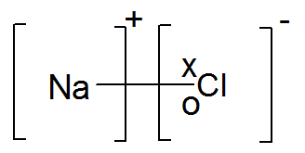
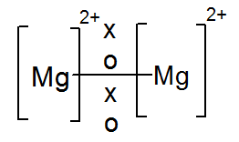
If the difference in electronegativity between the two atoms is large, the sharing of electrons is so uneven that the more electronegative atom will attract the electrons far more strongly. The electrons are not shared at all but an electron has essentially been transferred from one atom to the other. The more electropositive atom is positively charged and the more electronegative atom is negatively charged. The bonding is ionic.
If both atoms are electropositive, neither has a great ability to attract electrons and the electrons do not remain localised in the bond. They become free to move, both atoms gain a positive charge and the bonding is metallic.

