Slide 1
Y11 Thinking about A Level Physics!
Welcome to presentation 2!
What to expect from these resources:
A taste of what the content will look like
Clear structure to prepare for learning next year and help you “Bridge the Gap” from GCSE to A Level!
Learning goal | What is A Level Physics About?!
Prior knowledge | Combined or Triple Physics
Application | Begin to prepare for the transition from GCSE to A Level using independent study resources

Slide 2
Presentation 2:
Essential Practical Skills
for A Level Physics

Slide 3
Recording Data
Increased significant figures –
A calculation answer cannot have more significant figures than the numbers used in it. Here the average has more s.f. than the repeats.
Inconsistent precision - Each measurement should be made to the same level of precision.
Missing units - Every column heading must have units.
(ms⁻¹)
Incorrect mean – The mean should be calculated ignoring any anomalies.
Spot the 4 deliberate mistakes in the results table - (HINT - Only 1 mistake is a type of calculation error)
Going deeper… How could the table be improved further? Can you write a set of table rules?
Notes:
Challenge the class to work in groups to identify the 4 deliberate mistakes.

Slide 4
Rules for Results Tables
Tables should have clear headings with units indicated using a distinguishing mark before the unit, e.g. / or ()
It is good practice to draw a table before an experiment commences and then enter data straight into the table.
This may mean that you record results in an non-ascending or descending order which is fine when working in a lab book.
If you were to present the table or to use it to identify patterns, rewriting in ascending or descending order after the experiment would be helpful.
The independent variable should be in the left hand column.
The body of the table should not contain any units
Data within a column should be recorded to the same number of decimal places which is determined by the resolution of the measuring instrument used.
Any data which is a calculation from other data in the table should not be recorded to more significant figures.
Adapted from AQA Practical Skills Handbook.
Going deeper - What is the uncertainty in your measurement? This is determined by the resolution of your measuring instrument and could be recorded along with the heading and unit too!
Notes:
Completed using advice from the AQA Practical Skills Handbook which can be found here: https://filestore.aqa.org.uk/resources/physics/AQA-7407-7408-PHBK.PDF
Refer pupils to the rules for tables in the handout.
You may want to take the opportunity to conduct a simple exercise in data collection with the students to allow them to apply the rules for results tables and then they can peer assess each other.

Slide 5
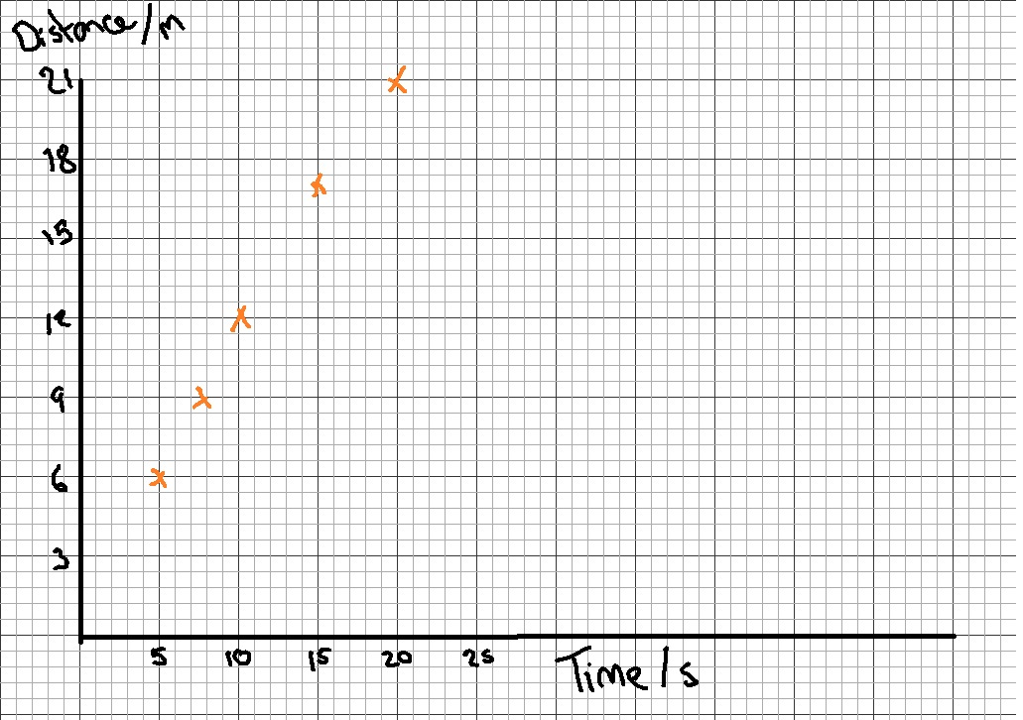
Rules for Graphing
Axis should be labelled with a unit which is separated by a distinguishing mark, e.g. / or ()
Data points should only be plotted using x or +.
The plotted points should occupy as much of the graph paper as possible in both the x and y directions.
Use at least half of the graph paper in both the x and y direction
Use a sensible scale - multiples of 1,2,5,10,20,50 etc.
Axis do not have to start at (0,0) but be careful if you need to work out the y-intercept.
A line of best fit should be drawn
Use a thin pencil line
Ignore anomalies and don’t force it through every plotted point
Have roughly the same number of points on either side
Not all line of best fits go through the origin (0,0) so don’t force it!
Correct
Incorrect
Notes:
Challenge the class to identify the rules that have been followed and have not been followed in the picture.
You may want to remonstrate drawing a line of best fit and or gradient triangle.
The line of best fit on the graph should not go through (0,0) but you may wish to demonstrate the effect of someone forcing it through the origin and discus with students the implication of this.

Slide 6
Types of Error
Random errors
Unpredictable and vary from measurement to measurement.
Random errors are always present.
They cause readings to be spread around the true value.
Their effects can be reduced by taking multiple repeated measurements and calculating a mean.
Systematic errors
A systematic error is the same for each measurement made.
It occurs when there is a problem with the measuring instrument e.g. a zero error; or the observation technique e.g. reading the wrong scale; or a problem with the environment e.g. the experiment was not conducted at standard temperature and pressure.
The whole experiment should be repeated using a different technique/instrument if a systematic error has occurred.
Notes:
Ask pupils to discuss and sort the examples giving reasons to support their decisions.
As an extension students could be asked to think of their own examples.

Slide 7
WORK OUT THE ANSWERS!
Sort the following into systematic and random errors:
Parallax error when measuring the meniscus on water in a measuring cylinder.
A faulty analogue ammeter that has a reading of 0.1A when it is not connected in a circuit.
Human reaction time error using a stopwatch to time the drop of a tennis ball from the ceiling to the floor.
Going deeper: How would you resolve these errors?
Notes:
Systematic error. Corrected by placing the eye in a position to take the reading at the bottom of the meniscus.
Systematic error. The machine needs to be ‘zeroed’ so that it reads 0.0A when not connected to the circuit.
Random error. Take multiple repeats and calculate a mean.

Slide 8
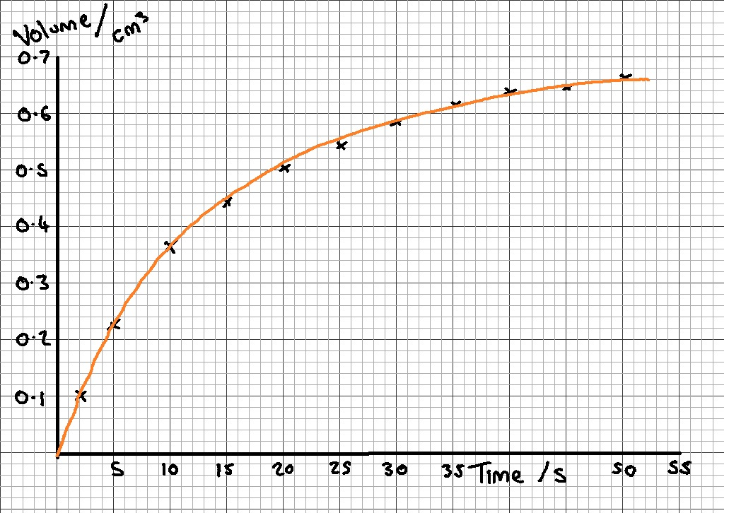
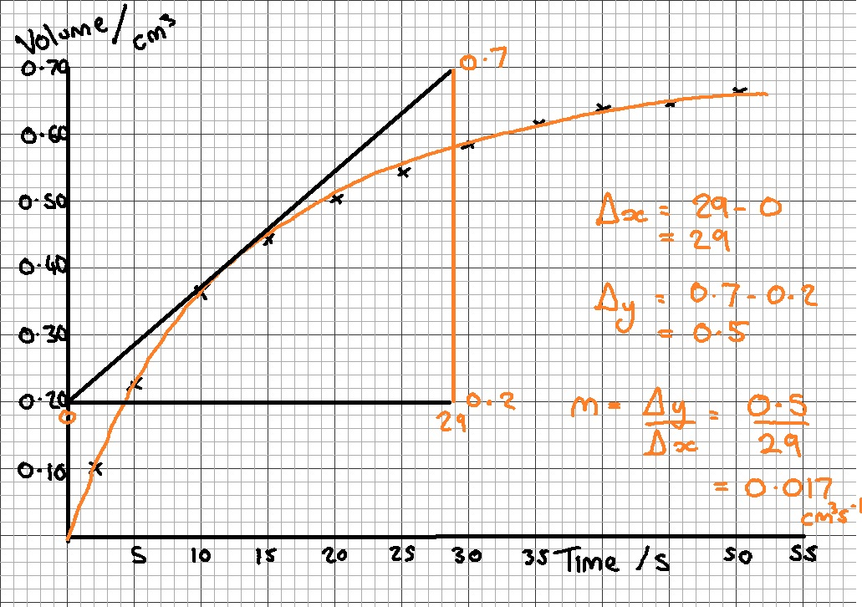
Finding the Gradient
Hint:
https://www.youtube.com/watch?v=ThiuJzMgxf8
When finding the gradient ‘m’ of a line always show your working and always draw a triangle!
The hypotenuse of the triangle should always be at least as big as half of the line of best fit.
If the line of best fit is a curve, draw a tangent to the curve at the point where the gradient is required.
The gradient ‘m’ can be calculated by:
m = change in y / change in x
= Δy / Δx
The unit for the gradient is the unit for the y-values divided by the unit for the x-values.
Notes:
Refer class to the notes on how to calculate a gradient
You may want to show a blank version of the graph or simply display the completed version.

Slide 9
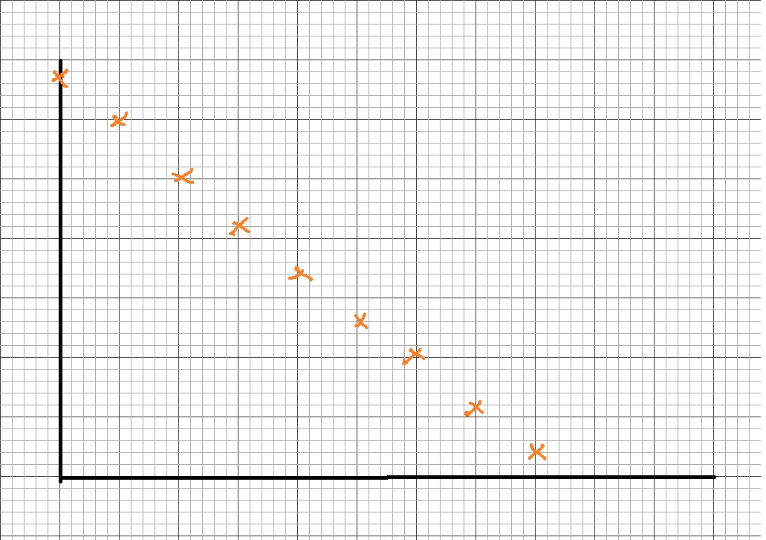
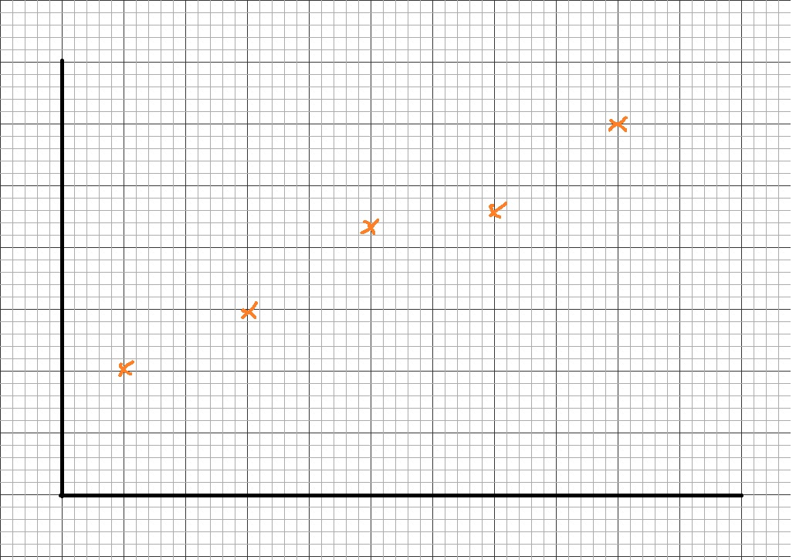
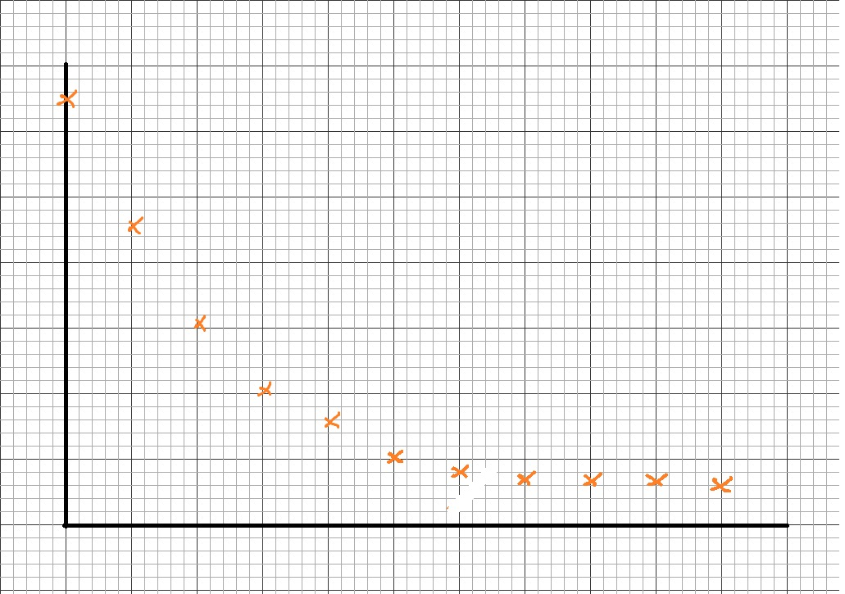
Graphing Challenge
WORK OUT THE ANSWERS!
Add a random selected range to the x and y axis by rolling a dice. Don’t worry about units!
Create a line of best fit on your graph
Measure the gradient (use a tangent for the curve). Don’t worry about units!
1 | 0 to 100
2 | 0.001 to 0.010
3 | 2200 to 6700
4 | 0 to - 100
5 | 0 to - 0.025
6 | 10000 to 10010
Going Deeper
Sketch the graph with a large random error and suggest how it could be dealt with .
Can you work out the y-intercept from your graph?
Notes:
Print out larger copies of the slide or copy and past the graph images onto single sheets.
Provide students with a dice to roll to determine the imaginary range of results on both the x and y axis. Students should roll twice, once for each axis.
Ask students to create a line of best fit and measure the gradient.
Students should peer asses eachother.

Slide 10
Using the Equation of a Line
𝒚 = 𝒎𝒙+𝒄
y= y variable
x=x variables
m= gradient
c= y intercept
Worked example:
y-axis = current ‘I’
x-axis = voltage ‘V’
Equation with both : V = IR
Re-arrange to make I subject:
$$I=\frac{1}{R}V$$
Match: $y=mx+c$
Find a physics equation that matches the variables used in your experiment.
Re-arrange it into the form y=mx+c
Match up the values to determine what the gradient of your graph and the y-intercept represent
y-axis quantity | x-axis quantity | Gradient (m) | y-intercept (c)
Q (charge) | T (time)
v² | s
I (Current)
0
a
u²
Notes:
Students will be familiar with the y=mx+c format from GCSE Mathematics but will not have had much practise in it’s application.
Go through the example of the current voltage graph showing how V=IR can be matched with y=mx + c by rearranging.
Ask students to try the two examples in the table.
Can students use the equation sheet to suggest any other straight line graphs that could be produces.

Slide 11
Summary Quiz
WORK OUT THE ANSWERS!
Calculate the mean of this set of data: 0.12, 0.14, 0.11
Define what is meant by a random error
State 4 rules for graphing
If a student had plotted a graph of force, applied ‘F’ to a spring on the x-axis and extension ‘e’ of the spring on the y-axis, what would the gradient represent? (F= ke)

Slide 12
Summary Quiz Answers
Calculate the average to this set of data: 0.12, 0.14, 0.11
0.12
Define what is meant by a random error.
An error that is always present and varies from reading to reading causing a spread of results about a true value OWTTE.
State 1 of the 4 rules for graphing.
Axis should be labelled with a unit which is separated by a distinguishing mark, e.g. / or ()
Data points should only be plotted using x or +.
The plotted points should occupy as much of the graph paper as possible in both the x and y directions.
A line of best fit should be drawn
If a student had plotted a graph of force, applied ‘F’ to a spring on the x-axis and extension ‘e’ of the spring on the y-axis, what would the gradient represent? (F= ke)
1/k

